Slide 1
AGA & ASMC Joint Spring PDT
April 2019
What is Good Leadership
Chuck Brooks, MBA, CPA, CGFM, CGMA
NASA Langley Research Center
Notes:
Chuck Brooks, MBA, CPA, CGFM, CGMA
Chuck Brooks is a member of the Office of Chief Financial Officer (OCFO) management team and is the Deputy Chief Financial Officer – Programs. Currently Chuck is on a detail to NASA Headquarters Chief Information Officer working as the governance executive for three Agency Information Technology Governance boards. Chuck has also worked in the following roles: as an Accountant, Team Lead – Reimbursables, Deputy Chief Financial Officer – Finance, Associate Director for PP&C - Game Changing Development Program Office, Associate Director of Advanced Analytics and Automation Office (AAAO) at the NASA Langley Research Center, and as Acting Chief Financial Officer.
Prior to joining NASA, Chuck worked in various leadership and management capacities at facilities of several companies such as Alcoa, Teledyne, and SAIC. In addition he has worked as a consultant implementing Enterprise Resource Applications (ERP) business solutions from Oracle and Baan in various business units of Alcoa and Nortel Networks.
Chuck received his BS in Administration from Radford University, with a concentration in Accounting, and his MBA (Concentration in E-Commerce) from Old Dominion University. Chuck is a Certified Public Accountant (CPA) in the state of Virginia and holds the Certified Government Financial Manager (CGFM) and Chartered Global Management Accountant (CGMA) designation.

Slide 2
Agenda
NASA & NASA Langley
What is Leadership

Slide 3
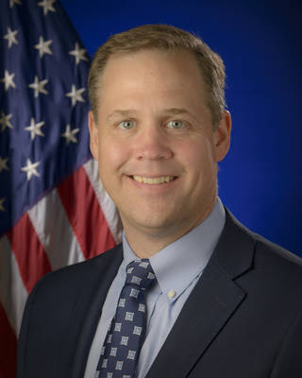
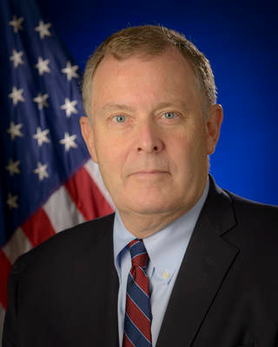
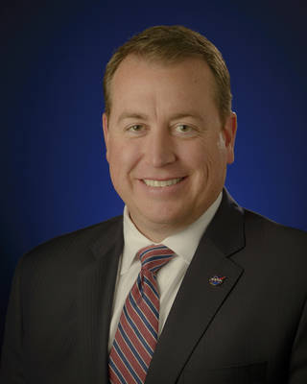
NASA Political Appointees
James Frederick “Jim” Bridenstine was nominated by President Donald Trump, confirmed by the U.S. Senate, and sworn in as NASA’s 13th administrator on
April 23, 2018.
James “Jim” W. Morhard was nominated by President Trump and confirmed to be NASA’s 14th Deputy Administrator. He was sworn in on October 17th, 2018.
Jeff DeWit was unanimously confirmed by the U.S. Senate on March 14, 2018, to serve as NASA’s Chief Financial Officer.
To read more, go to:
https://www.nasa.gov/about/highlights/bridenstine-biography.html
https://www.nasa.gov/feature/jeff-dewit-chief-financial-officer
Notes:
3 political appointees

Slide 4
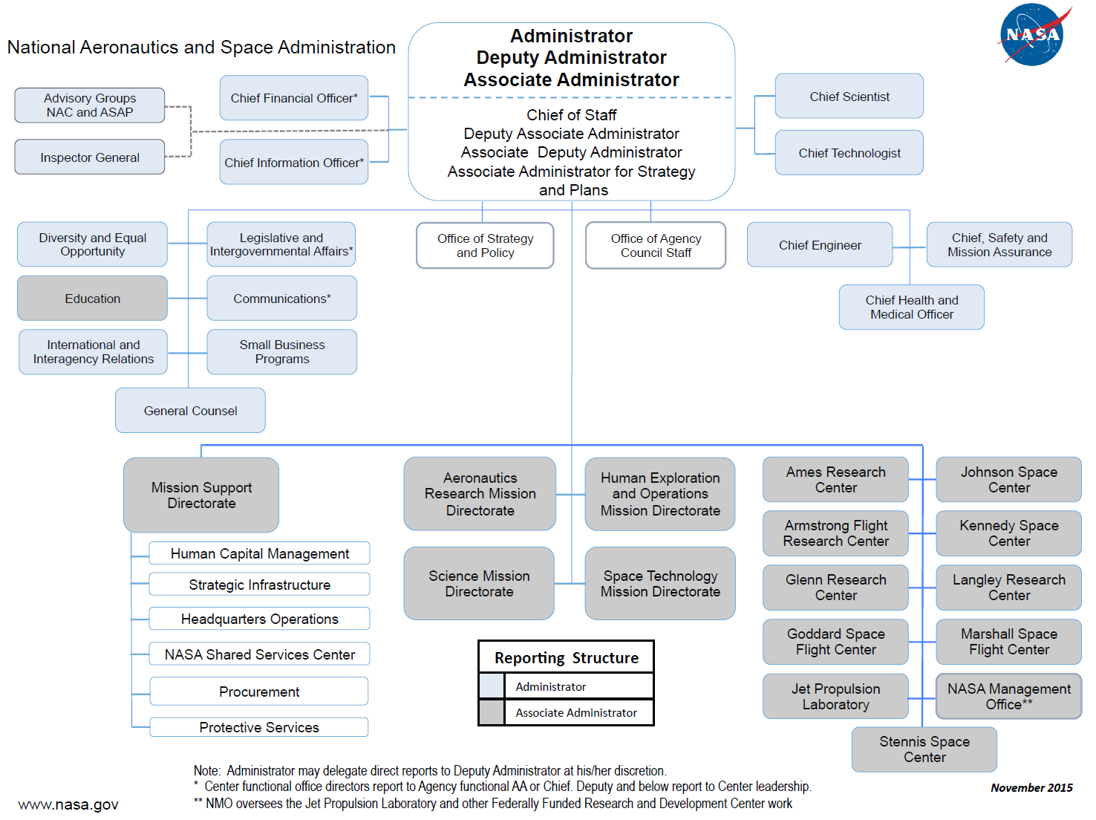
NASA Organization
Notes:
For the 7th year in a row NASA named the Best Place to work out of 17 Large Federal Agencies

Slide 5


A Storied Legacy, A Soaring Future
https://www.youtube.com/watch?time_continue=15&v=5Ry-G5tvMmM

Slide 6
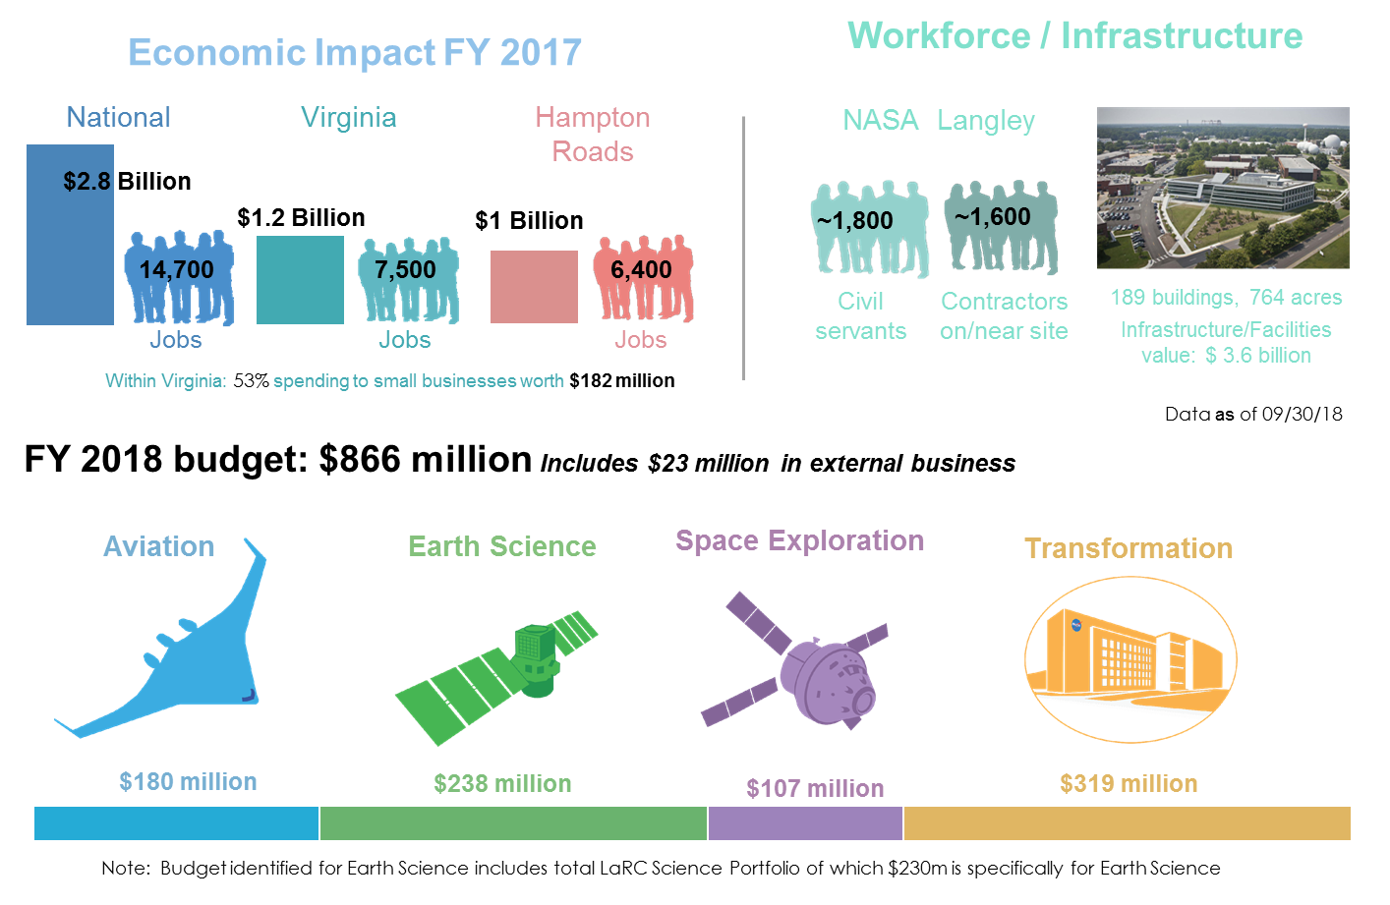
NASA Langley At a Glance

Slide 7
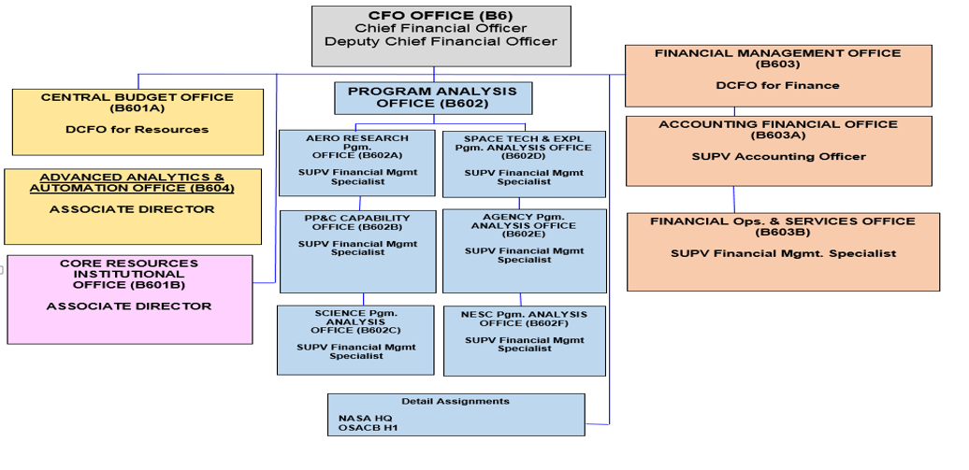
NASA LaRC OCFO

Slide 8
Leadership – What is it?
What is Leadership
Different types of Leaders
Our EXPERIENCES
Thoughts for Moving Forward
Notes:
Thank you for inviting me here today – I am really looking forward to our dialogue today on how we can make a difference.

Slide 9
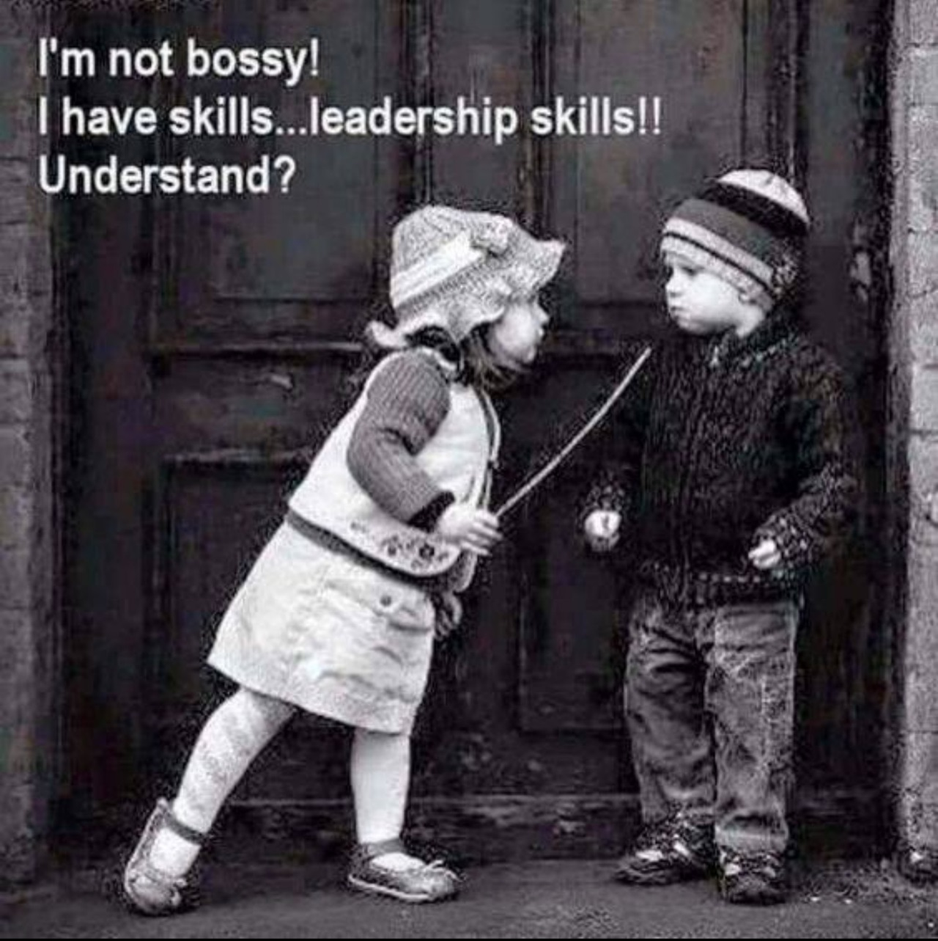
Leadership – What is it?
Notes:
I am sure none of us has ever experienced someone like this

Slide 10
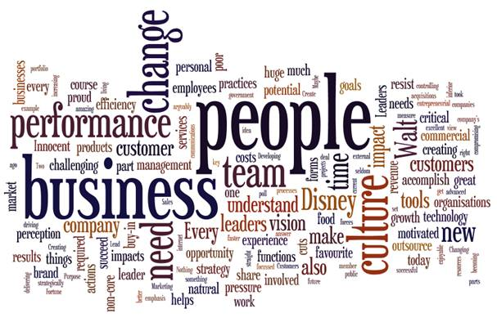
What is Leadership
Provide Information,
Knowledge & Methods
VISION
Coordinate and Balance Conflicting Interests
Notes:
Wow is this what leadership involves:
There are a lot of words on here and many of us in a leadership role probably feel a bit overwhelmed at times…
To me the main thing is the PEOPLE – I believe if you really take CARE of people under your leadership, make sure they know the good things they have done and you take an interest in helping them succeed (i.e. having the tough conversations around improvements) then things like customer service take care of themselves, because people feel vested, appreciated, and want to be a part of a high performing team.
Begins by establishing a clear vision,
sharing that vision with others is very important so that they will follow willingly and take an ownership in it
providing the information, knowledge and methods to realize that vision, and
coordinating and balancing the conflicting interests of all members and stakeholders.
http://www.businessdictionary.com/definition/leadership.html
Time Management
How to get it done
Being responsible for others
Empowering; Quality of work; Approach/How; Helping them grow/develop
Speed
Is it quicker to do it yourself vs. train; Short term vs long term
Cultures
Do you feel this has an impact on you as a leader?

Slide 11

Different types of Leaders
Leader
Manager
Supervisor
Notes:
I feel we can look at as the traditional pyramid….
BUT – there are formal and informal leaders and I believe this is where we all can have an impact!

Slide 12
Different types of Leaders
Leader
  Typically - Strategic in nature
Manager
  Balancing needs of today
  and preparation for tomorrow
Supervisor
  More focused on today
Notes:
Leader
Typically strategic in nature – VISION, very forward looking
Up & Out
Supervisor
More focused on today
Telling folks how to get it done, when to get it done
Step by Step
Manager – poor folks stuck in the middle
Balancing needs of today with prep for future
Proverbial Rock & hard place
Collectively all looking @ Who/What/When/Why/How just with various focuses/time horizons
My experience, Supervisor was hard but the most difficult leap was to a Manager role, stuck in the middle being pulled by your boss and the supervisors trying to balance todays requirements and prepare for tomorrow. Balance is tough, people – development of current folks towards skills you anticipate you will need 5-10, maybe 20 years from now, and how will you balance those needs with processes and policies. Probably based on my experiences it became easier over time and my confidence improved.

Slide 13
Our EXPERICENCES
Have you worked with a leader that was/is
  Good
  Bad
Why do you say they were/are
  Good
  Bad
Has this impacted your leadership style
  Why
  How
Notes:
So I have a few questions for you & please provide some feedback on your experiences
Will need to advance the lines as you speak.
Do the bad ones stand out more in your mind than the good ones?
Is there common elements with the good/bad ones?
Do you think we each form our own opinion on who is good or bad – is the view consistent across all employees?
Who are you most likely to “follow over the cliff” willingly?

Slide 14
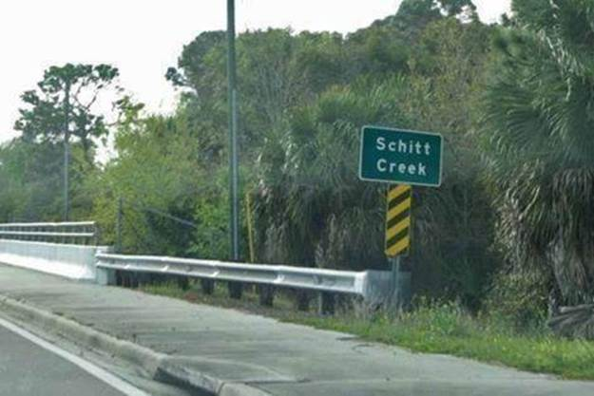
Our Experiences
None of us like to be caught up
https://www.facebook.com/pages/Schitt-Creek/194832213872757
Notes:
None of us like to be caught up here with or without a paddle so lets talk about thoughts for moving forward
Actually Exists in Fishersville, Va.
Even has a Facebook Page (https://www.facebook.com/pages/Schitt-Creek/194832213872757)
Just west of Waynesboro, Va before you get to I64 & I81 Interchange

Slide 15
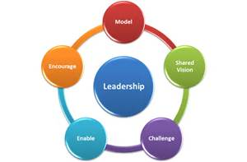
Thoughts Moving Forward
The 5 practices of Exemplary Leadership®
Model the Way | Inspire Shared Vision | Challenge the Process | Enable Others | Encourage the Heart
Behavior you expect from others | Dream what can be | Find and accept challenges | Leadership is a team effort | Appreciate commitment and contribution of others
Provide clear guiding principles | Confidence to do great things | Transform the status quo | Foster collaboration | Form team identity
Recognize Value of others | Desire to act | Recognition of new ideas and be the early adopter | Build Trust | Guidance through hard times
“People first follow the person then the plan” | People will not follow if they are not “owners” of vision | Be open to learn new things – Ok to fail - Learn from it | Enable others to do good work | Tone from the top
Notes:
The 5 practices of Exemplary Leadership
Overview
Jim Kouzes and Barry Posner started developing the idea for The Leadership Challenge when they were planned to present about leadership at a two-day conference. Academics at Santa Clara University, Kouzes and Posner were set to speak after Tom Peters, who was presenting about successful companies. Kouzes and Posner decided to focus on individual leadership skills.^{[2]} The name for the book came from the concept of the challenges that take place to "make extraordinary things happen", according to Kouzes in 2012.^{[3]}
"The Five Practices of Exemplary Leadership"
The Leadership Challenge uses case studies to examine "The Five Practices of Exemplary Leadership", as researched and developed by Kouzes and Posner. Their first surveys for the five practices started in 1983, by asking people "What do you do as a leader when you're performing at your personal best?"^{[3]} Over 30 years, they have done thousands of interviews and collected approximately 75,000 written responses.^{[4]} Kouzes and Posner identified five common concepts in their survey, hence the five practices, which are: "Model the Way," "Inspire a Shared Vision," "Challenge the Process," "Enable Others to Act," and "Encourage the Heart".^{[3][5]} Kouzes cites that the last practice, "Encourage the Heart", is the most uncommonly seen in leadership roles. The concept focuses on being sincere, including sincere celebrations devoted to recognizing employee successes.^{[3]} "Model the Way" encourages leaders to behave the same way they encourage others to behave, with their own voice and values.^{[4]} "Inspire a Shared Vision" focuses on developing a vision and series of goals that everyone at the organization cares about and works towards collectively, with clear understanding.^{[1]} "Challenge the Practice" encourages moving "outside the boundaries" to be innovative to make change. "Enable Others to Act" is trust-based, encouraging leaders to create a safe and trusting environment for people to collaborate, experiment, and engage.^{[3]}
Important leadership traits
Kouzes and Posner believe that leadership is learned, not something one is born with.^{[6]} They look at traits seen within introvert and extrovert personalities, and examine how they can be developed into leaders by using those skills. For example, extroverts lean towards sharing of their thoughts and ideas with energy to larger groups, when introverts tend to be more quiet and one-on-one in their engagement about ideas to others.^{[7]} A survey featured in the book shows that honesty is the most respected personality trait that a leader can have.^{[8]} Three additional traits that leaders around the world share are forward-thinking, inspiration, and competency.^{[4]}
The book also looks at work styles and how people function in organizational settings, and how to improve skills like visionising based on their personality traits.^{[7]} Kouzes and Posner express an importance in having a "shared vision" for everyone on one's team or at one's company. If a shared vision can be developed and exhibited, staff will be more prone to feeling confident and motivated in their job. Symbolic language like metaphors and storytelling are also important components to leadership skills. Kouzes and Posner believe that symbolic language helps in persuasion and gathering buy-in. Using emotive words and images also helps in inspiring those leaders are leading or hoping to lead. Positive thinking and expression is another key concept in leadership within the book. Positivity can rub off on others around the leader, leading to productivity and satisfaction. Balancing positivity with negativity is important, with positivity a tool that leaders can use to get buy-in from staff for projects and programs. Charisma, honesty, and being emotional are also seen as good signs of leadership.^{[1]}
I think we all can do this as formal and informal leaders to help our teams/organizations be more successful!
NASA is one of the best places to work in the federal government and I feel it is because we do many of these things. The tone has been set at the top by our previous Administrator Charlie Bolden.

Slide 16
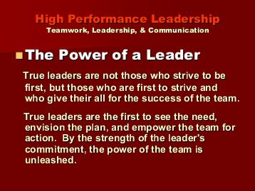
Thoughts Moving Forward

Slide 17

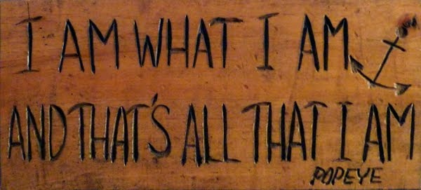
Thoughts Moving Forward
Leadership is not about personality
It’s about behavior
  an observable set of skills and abilities.
Be yourself
  Know yourself
  Utilize your strengths
  Live and Learn
    Mentor: Get one/Be One
    Utilize training to improve
Notes:
Be honest and upfront with people- don’t try and be something you are not.
Be Humble
Be realistic
Be Consistent
Know yourself; strengths weaknesses tendencies, stress brings out natural tendencies

Slide 18
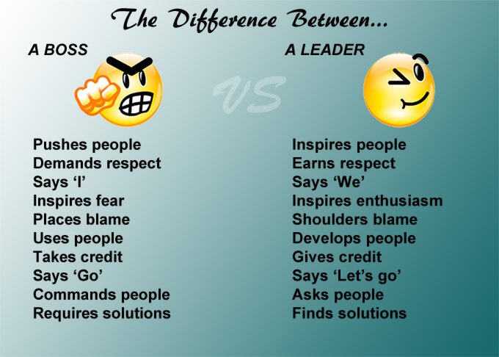
Thoughts Moving Forward
Notes:
Does a boss succeed in the long run or
do they burn people out and
have high rate of turnover?
Higher costs for training
Probably less efficiency
Does work stop when the boss is gone

Slide 19
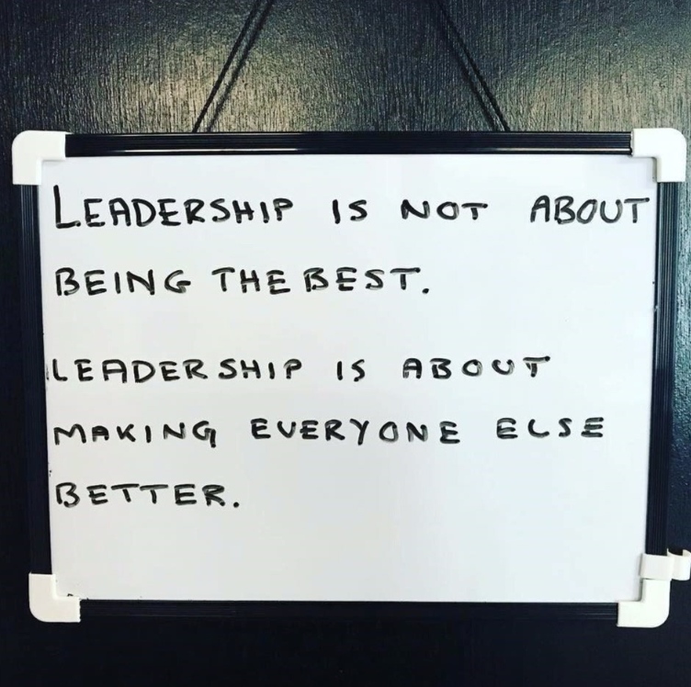

Slide 20
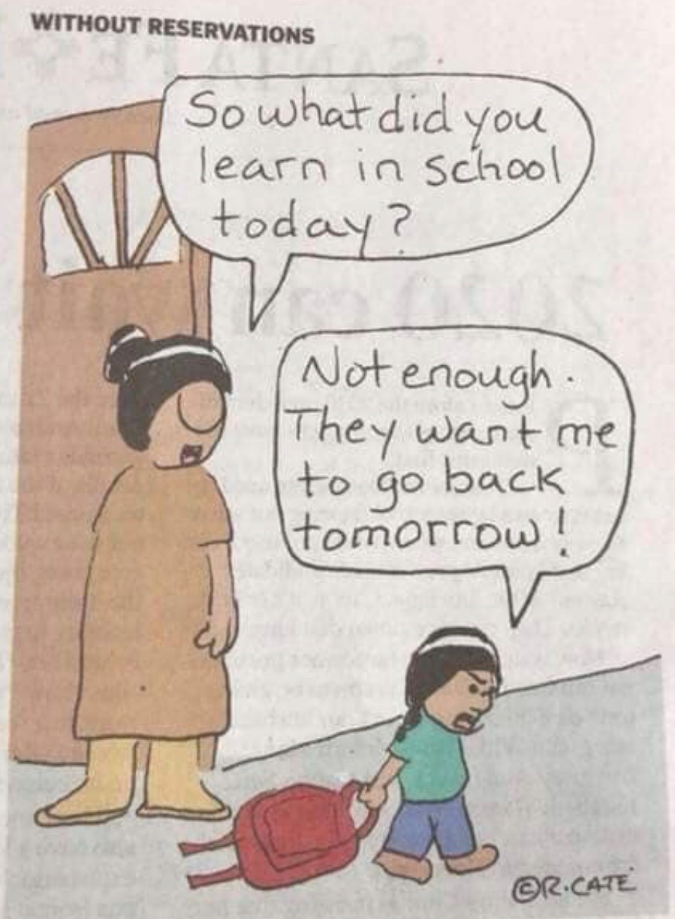
Thoughts Moving Forward
Notes:
2012 - $164.2B in US on Training & Development
Top 3 areas:
~$22.2B Managerial & Supervisory
~$17.7B Mandatory & Compliance
~$16.3B Process, procedures, business practices
While these stats are a bit dated, training has been well funded. I think it is important to work on improving what we do well as much as working on our areas of weakness. We can be successful by surrounding ourselves with team members who’s strengths cover/compliment our weaknesses. So my suggestion is to find a good balance for your training needs.
U.S. organizations spent $164.2 billion on employee learning and development in 2012, according to the just-released findings of ASTD’s 2013 State of the Industry report sponsored by Skillsoft and the CARA Group, Inc.
The report’s findings demonstrate that despite a continuously changing economic environment, organizations remain committed to training and development. Senior executives understand that a highly skilled workforce is a strategic differentiator. They are investing in the development of their employees and using technology, instructor-led training, and blended solutions to effectively meet training challenges.
ASTD’s 2013 State of the Industry report is based on a survey of 475 organizations representing a diverse sample of industries, sizes, and locations. For comparative analysis findings are reported for three data sources: a consolidated source of all organizations; a data source pulling from the 28 BEST Award winning organizations; and a data source reflecting 32 Fortune Global 500 organizations.
Advertisement
Key findings are:
$164.2 billion spent on learning and development in 2012.
61 percent of expenditures were on internal expenses ($100.2 billion).
Per-employee spending remained stable in 2012, at an average $1,195 per employee ($1,182 in 2011).
11 percent of expenditures went to tuition reimbursement ($18 billion).
As a percent of payroll, direct expenditure on learning increased from 3.2 to 3.6 percent.
Employees averaged 30.3 hours of training in 2012. Employees in BEST organizations used substantially higher amounts of training, averaging 57.7 hours each—an all-time high.
Technology-based delivery of instruction rose to 39 percent of formal hours, up from 37.2 percent in 2011.
The top three areas of training content in 2012 were: managerial and supervisory (13.5 percent); mandatory and compliance (10.8 percent); and processes, procedures, and business practices (9.9 percent).

Slide 21
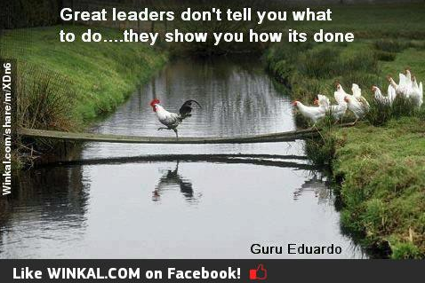
Thoughts Moving Forward

Slide 22
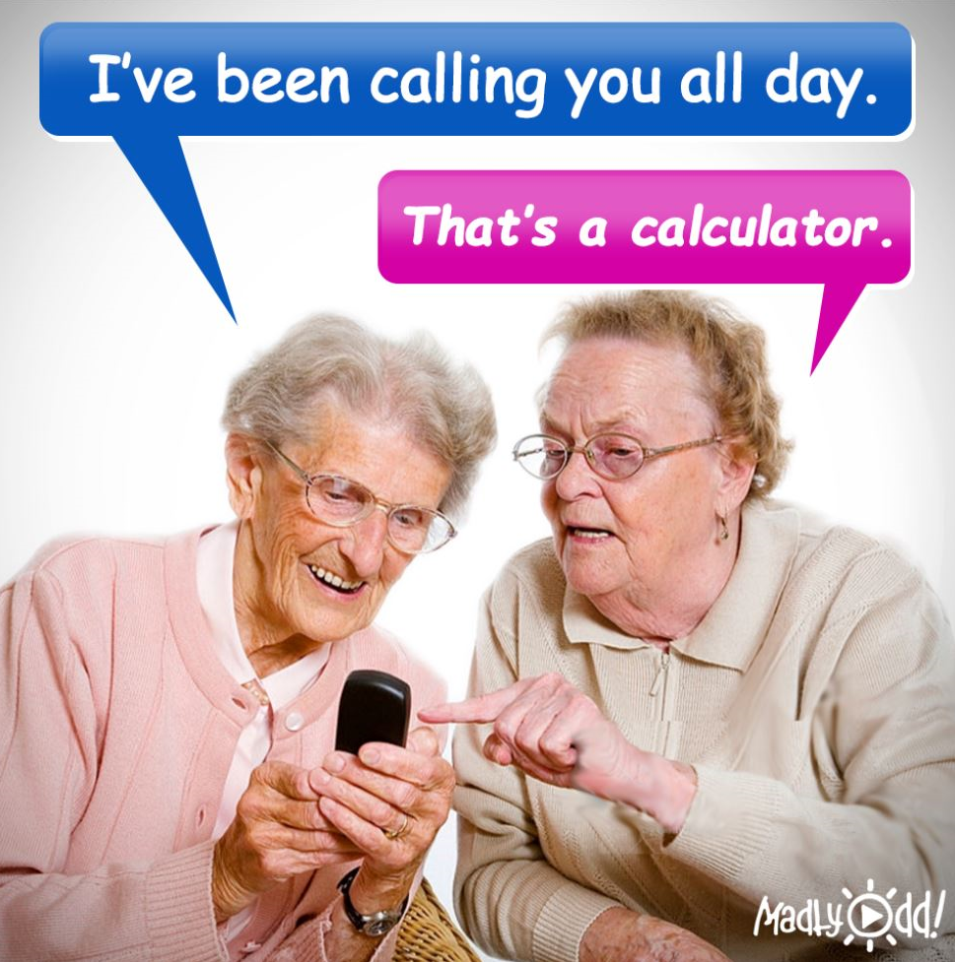
In Closing

Slide 23
Questions
Chuck Brooks
NASA
757-864-1294
charles.e.brooks@nasa.gov
Notes:
Thank you again for inviting me to speak & I want to thank you for the engaging discussion today.

