Slide 1

Challenge of Change ‘Non’ Success Story:
How (and Why) a fired City Auditor got a $775,000 Jury Award
(The judge reduced it to $150K, but he settled for $300K)
AGA/ASMC Spring 2019 PDT – April 25, 2019 Jay Poole, CPA,CIA,CFE,CGMA
(& expert witness!) City Auditor
City of Chesapeake, Virginia
5

Slide 2


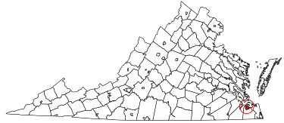
Facts – Portsmouth, Virginia
33.3 square miles (land)
Tenth Largest City in Virginia
Population – 91,940 (2019 Estimate)
Budget - $720,102,069 (FY 2019)
Employees - 1,858 (FY 2019)
Council/Manager Form of Government
Hired first City Auditor on April 2, 2013
5

Slide 3
on April 26, 2016.
The Portsmouth, Virginia City Council voted to fire their City Auditor
WARNING!
Some auditors may find this video disturbing to watch!
https://www.youtube.com/watch?v=aIz0NKJZFjQ
WAVY TV News 4-26-16
5

Slide 4
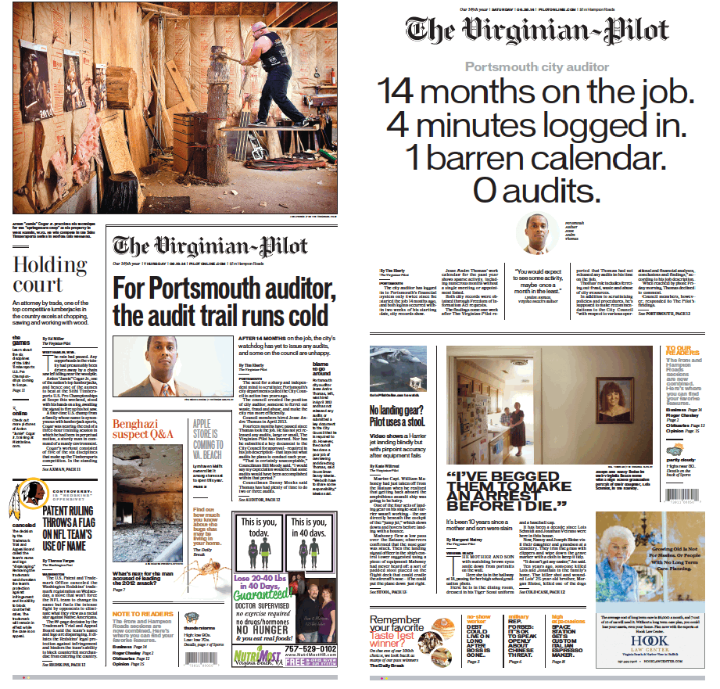
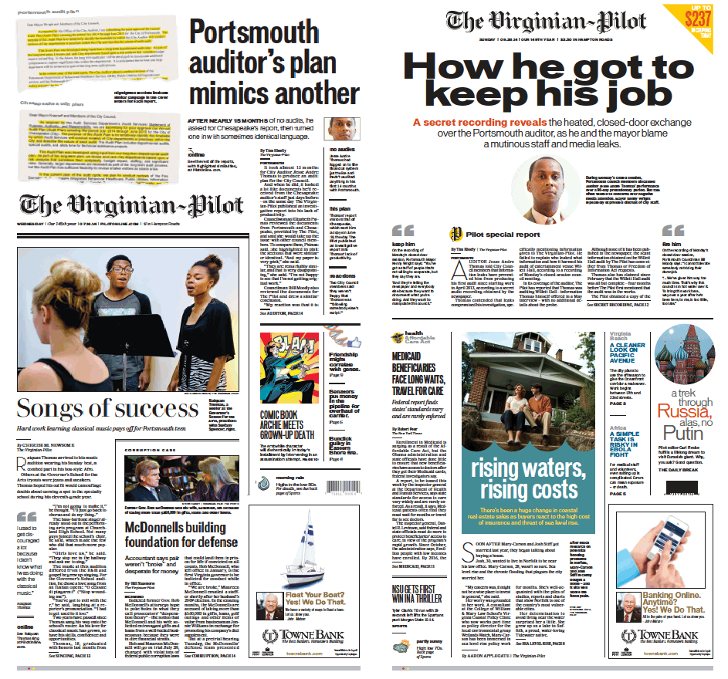
This firing occurred after:
6-19-14
6-28-14
7-16-14
9-28-14
5

Slide 5
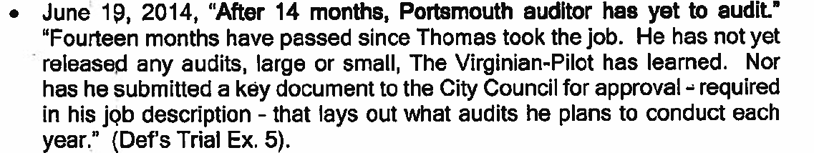
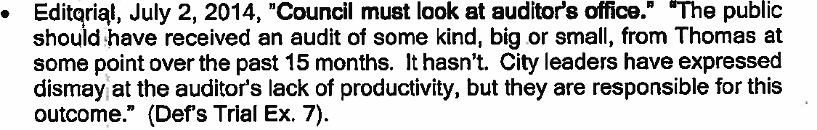
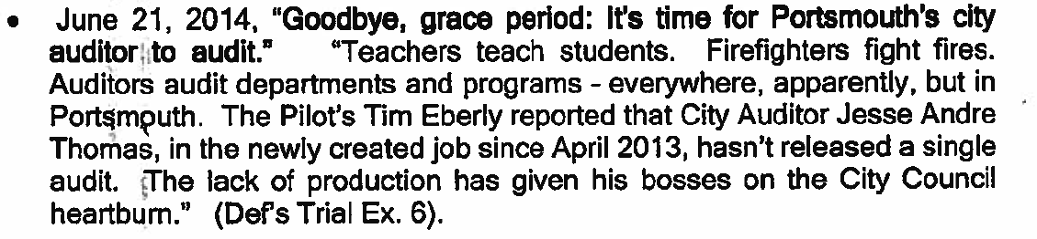
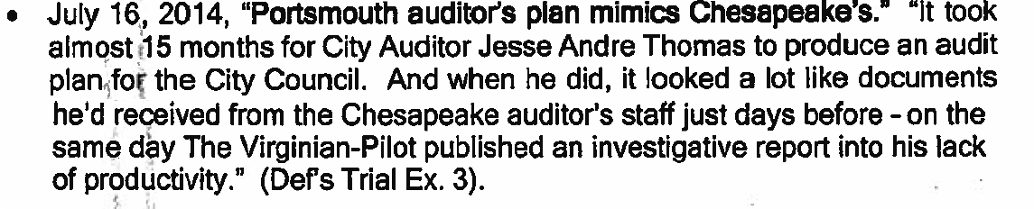
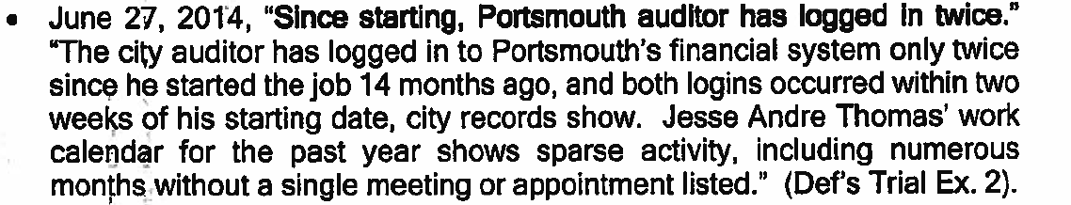
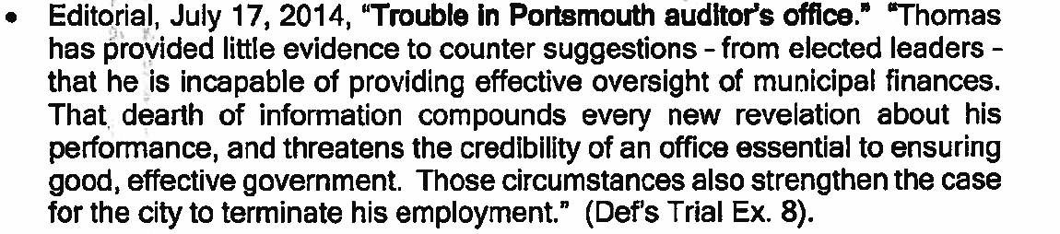
Some of which included:
From Judge’s Final Opinion – January 17, 2019
5

Slide 6
So how could this occur?
https://wtkr.com/2018/11/21/jury-says- portsmouth-vice-mayor-defamed-fired- city-auditor-must-pay-775k/
WTKR – Norfolk – 11/21/2018
5

Slide 7
Here’s a Hint…
https://www.youtube.com/watch?v=RLySXTIBS3c
Trading Places - 1983
5

Slide 8
What We Will Cover:
Cases Summaries – Both Cases
How and Why the fired City Auditor won
the cases (and why the judge reduced the first jury award)
What the City Auditor and City Council did right and did wrong
The Media’s “Crop(ped)” report(s) and how they impacted the outcomes
Tips to avoid other Challenge of Change
‘Non’ Successes
5

Slide 9
CASE 1 SUMMARY
February 17, 2017 - Case filed against Vice Mayor - $1.5M
November 13, 2018 - Trial began
November 19, 2018 - Trial ended
November 19, 2018 - Jury awarded
$775,000 to fired City Auditor
January 17, 2019 - Presiding Judge reduced the award to $150,000
March 7, 2019 – (former) Vice Mayor appeals
March 11, 2019 - fired City Auditor appeals
March 28, 2019 - settlement
9

Slide 10

CASE 2 SUMMARY
April 19, 2017 - Case filed against City Councilman - $1.5M
March 28, 2019 - $300,000 settlement plus court costs (for both cases)
This outcome was unusual because:
Defamation cases tend to be difficult to win;
The fired City Auditor had been designated
as a “Public Figure” by the court. As a result, his burden of proof was even higher

Slide 11
How and Why the fired City Auditor won the first case (and why the Judge reduced the first jury award)
https://www.youtube.com/watch?v=1013K8fJfo8
https://www.youtube.com/watch?v=pM1cbckIXSo
WAVY TV News 3-10-16

Slide 12


Opinion Excerpts – Case 1:
Page 2 - In contrast, the statement that she "got nothing for two years” was false and implied more than that Plaintiff had not provided regular updates. It suggested that he had provided nothing at all. No updates, no nothing. The jury was entitled to interpret this statement, and they did not accept the meaning that Defendant urged. They apparently did not believe that Defendant was telling the television audience only that she got no regular updates.
Page 5 - When defendant spoke about Plaintiff on-camera for approximately 10 seconds in March of 2016, Plaintiff had been bludgeoned by the local newspaper in the above dozen or more articles, all discussing his lack of productivity and insufficient job performance.
Page 9 - Moreover, it appears that they intended to punish her for all of the negative publicity that Plaintiff had received and not just the effects of one interview in March of 2016.
From Judge’s Opinion – January 17, 2019

Slide 13
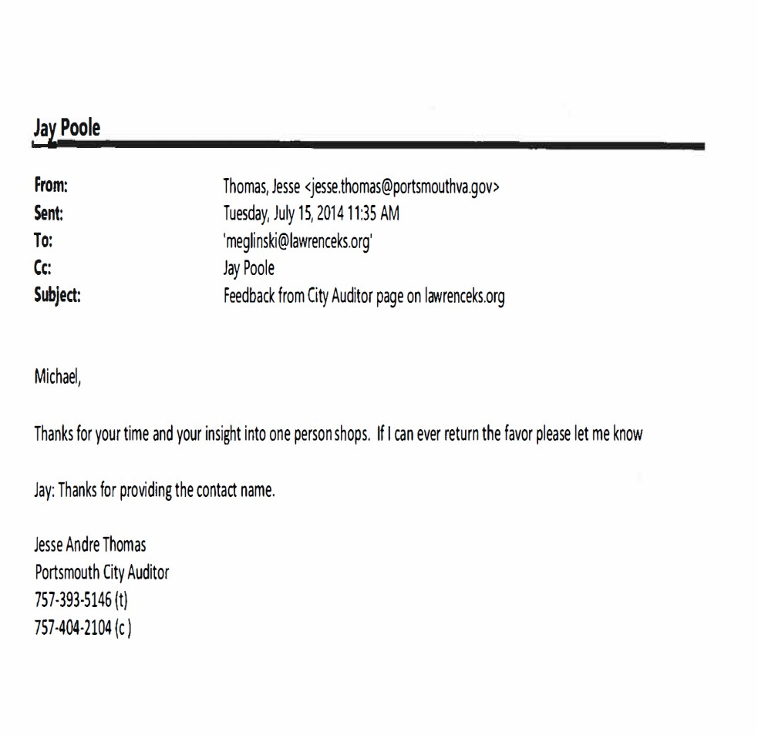
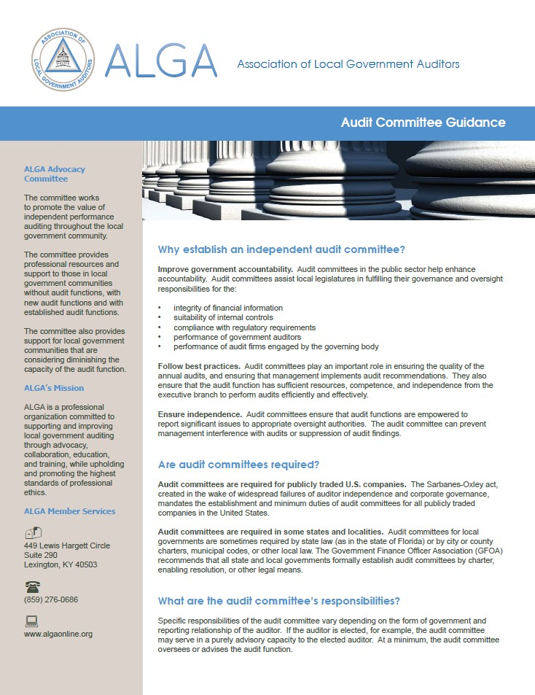
What the City Auditor got right
Outreach to ALGA – July 2014

Slide 14
What the City Council got right:
During Monday's closed session,
In the end, five council members
-including one who left the meeting early, his colleagues said, to attend a campaign forum - put their support
council members discussed Thomas'
performance probationary veered to
over period.
a 90-day But talk often
concerns over negative
behind Wright, Cherry
the auditor. Three of those -
Meeks and Vice Mayor
media attention. Mayor Kenny Wright repeatedly expressed distrust of city staff members. He argued that The
Paige gated
- live in the same
subdivision as Thomas.
- Cherry, who only briefly attended the meeting and left through a side door, lives two doors from Thomas in the same cul-de-sac.
Pilot's
manipulated
coverage has been
by city employees to
keep Thomas from uncovering fraud, waste and abuse at City Hall. Meanwhile, the most sensitive issue
Thomas
members
described
involved
to council
a $3,000
Only one council member, Bill Moody, advocated to fire Thomas. Councilwoman Elizabeth Psimas, who also had said she wanted to let Thomas go, was attending an out-of-state funeral on the day of the
discrepancy in ticket sales at Willett Hall.
meeting.
City Council support for City Auditor
Virginian Pilot 9-28-14
14

Slide 15
What they both got wrong:
Thomas did concede one area where he has room for improvement: communication.
"That's something I need to do a better job with," he said.
Meeks, however, offered Thomas some additional feedback before the auditor left the room. "Can I give you a little bit more advice?" Sure, Thomas said. "The newspaper guy, I wouldn't talk to him," Meeks said. "Don't even say a word to him," Randall added. "I'm just saying," Meeks said. "That's how it all started." "Just simply say, 'No comment,' " Edmonds said. When Thomas left the room, that's exactly what he did.
Communication (or lack thereof) by City Auditor and City Council
Virginian Pilot 9-28-14

Slide 16

Now, about those “Cropped” reports,

Slide 17
“Guidance and Advice”?
"He asked for a copy of our audit plan to see what it looked like," Poole said. Four days later, Thomas shared his audit plan with City Council members.
He publicly presented it to the council on July 8.
Poole, who has provided guidance and advice to Thomas, reviewed the documents Tuesday at The Pilot's request. Poole acknowledged similarities but said he wasn't offended by them.
"It's not copywritten," he said. "He's perfectly welcome to use it."
Poole also said new auditors commonly rely on the work of other auditors to guide them.
"And then, as circumstances change, they will adapt or make adjustments in the way they present their audit plan," he said. "There's a learning curve."
Something is definitely missing here…
Who are these “other auditors”?
Virginian Pilot 7-16-14

Slide 18
We need “greater collaboration between cities”
JAY POOLE doesn't work for Portsmouth, but perhaps he should.
The City Council might get a better return, and more credible and comprehensive information, by offering to compensate the Chesapeake auditor directly for his work, rather than finding it slightly altered and submitted by Portsmouth's own auditor.
Because that appears to be what happened….
Indeed, it's difficult to see how Portsmouth could be worse off without Thomas. His greatest contribution as auditor of Portsmouth so far may be to highlight the office of municipal auditor as one area for greater collaboration between cities.
Hmmm… Ever heard of…
Virginian Pilot Editorial 7-17-14

Slide 19

What’d he say? (w/apologies to Ray Charles)
What’d I Say Ray Charles - 1959
He also noted that Poole's cover letter was not an original. He said it was derived from an Institute of Internal Auditors' template
document.
As Thomas spoke, City Councilman Bill Moody interrupted him. "Quite frankly - and I'm speaking for me - I don't think it's an efficient use of our time to rebut a week-old newspaper (article)," he said. "I think there's a lot we do need to discuss, but I don't think now's the time to do it”.
Two other council members, however, encouraged Thomas to finish his presentation, during which he also revealed the risk assessment that he created to decide which audits to do.
What did the Council Members actually say?
Virginian Pilot 7-17-14

Slide 20
What he ACTUALLY said
https://www.youtube.com/watch?v=j5BdJ_IUzNk
“I respect what Councilman Moody is saying but I think it’s a good idea to board it up – since it’s going to be written up from a different perspective, it needs to be corrected so that all watching will know the right way.”
Council Member Curtis Edmonds , 7-21-14
Wonder why they didn’t quote THIS directly?
Portsmouth City Council Work session 7-21-14

Slide 21
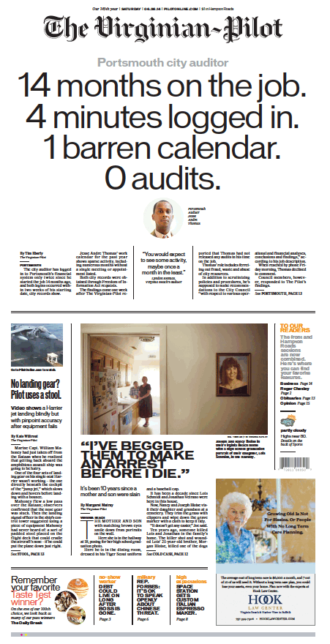
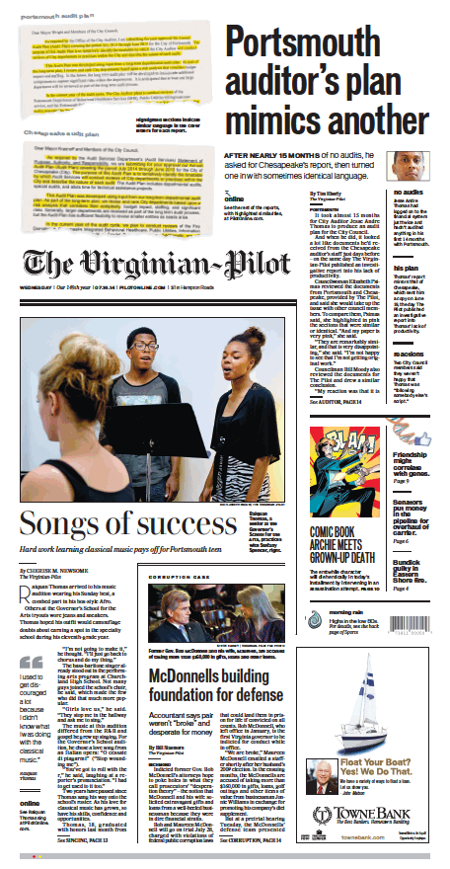
When the Jury Award was announced…
Portsmouth vice mayor must pay ex-city auditor $775K, jury rules
Thomas was hired in April
2013, and the
three years
following
were
tumultuous. The reported in June
Pilot 2014
that he had logged into the city's financial system twice in his first 14 months on the job. When he produced an audit plan, 15 months into his tenure, it resembled documents he
had received from the Chesapeake auditor's staff days before.
The newspaper revisited these two front page stories…
Virginian Pilot 11-21-18
21

Slide 22
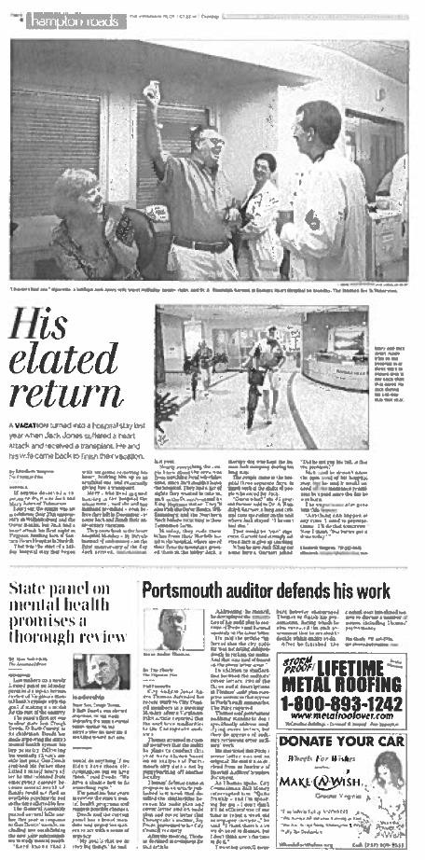
But completely ignored this…
Portsmouth auditor defends his work
In addition between the letters, two of descriptions in
to similarities auditors' cover the three audit
Thomas'
audit that audit
plan comprise sentences
appear in Poole's
summaries, The Pilotreported.
Thomas auditing specifically
said government
standards
address
don't
modifying
cover letters, but they do approve of auditors reviewing other auditors' work.
He also noted that Poole's cover letter was not an original. He said it was derived from an Institute of Internal Auditors' template document.
Virginian Pilot 7-22-14 (from page 4)
22

Slide 23

When the Jury Award was reduced…
Judge slashes judgment against council member
In court records, Connell cited an interview with WAVY-1V reporter Joe Fisher in which Psimas "intended to suggest that Thomas had done nothing since he had
been hired as the city auditor."
But by the time that interview happened in March 2016, Thomas had "already been unflatteringly portrayed in many articles criticizing him in The Virginian- Pilot," Hall wrote in her opinion, quoting 13 pieces about his job performance.
Thomas' attorney told the jury that they were "the only people who can restore his reputation" after the comments made on television, but Hall found he didn't show sufficient evidence to illustrate the effect that the interview had on Thomas.
"His testimony about the effect of the defamation on him was unremarkable," she wrote, adding that Thomas did not adequately distinguish between the hurt caused by Psimas' interview and that caused by his firing. He wasn't entitled to compensation for damages caused by anything but Psimas' comments, the judge said.
Because most of the damages awarded to Thomas were punitive, Hall concluded that "the verdict was the product of passion or prejudice or some misunderstanding of the facts or the law."
The article included this… Virginian Pilot 1-30-19
23

Slide 24
But didn’t include any of this…
Page 2 - In contrast, the statement that she "got nothing for two years” was false and implied more than that Plaintiff had not provided regular updates. It suggested that he had provided nothing at all. No updates, no nothing. The jury was entitled to interpret this statement, and they did not accept the meaning that Defendant urged.
Page 5 - When defendant spoke about Plaintiff on-camera for approximately 10 seconds in March of 2016, Plaintiff had been bludgeoned by the local newspaper in the above dozen or more articles, all discussing his lack of productivity and insufficient job performance.
Page 9 - Defendant refers In her motion to a question from a juror which the Court did not permit to be asked, which read: "Does [the witness] believe the articles written about Mr. Thomas were hit pieces aimed to discredit Mr. Thomas' work and tarnish his reputation as an auditor?”
From Judge’s Final Opinion – January 17, 2019
24

Slide 25
The unfortunate result of this reporting
GMM - This judgement will be invalidated upon appeal. Laws regarding slander and libel have a much higher threshold for public officials. The lawyer representing Ms. Psimas must have done a very poor job.
MW - So much for freedom of speech by an elected official when there is wrongdoing. What about the truth to her statements? That is a defense in these types of lawsuits. Psimas was a watchdog for her constituents…
This verdict is wrong and I am surprised the judge even let it stand.
I suspect there is more at play with this jury
than the alleged defamation.
M2C - You have got to be kidding me! Apparently he wasn't doing his job. I don't see where the comments were detrimental.
TWD - But since they were the factual truths that Psimas and Moody were telling the paper, there was no libel or slander. Just a stupid jury and a smart lawyer.
JB - Reply to @Jesse Thomas: With that said I still can't believe you won. What did you even do for Portsmouth to earn your pay? At the time you were the auditor money was being wasted, bills went unpaid and money that was owned the city wasn't being collected. Yet you logged into your computer only twice.
The city should sue you for back pay. VBC - Crazy ruling
GMM - This lawsuit is the equivalent of
Richard Nixon suing the impeachment
rel got right:
committee and all who testified for all the bad things they said about him. When a public criticism is true, how can that be a
problem?
Online comments on City Auditor stories
Virginian Pilot 11-21-18 & 1-30-19
25

Slide 26

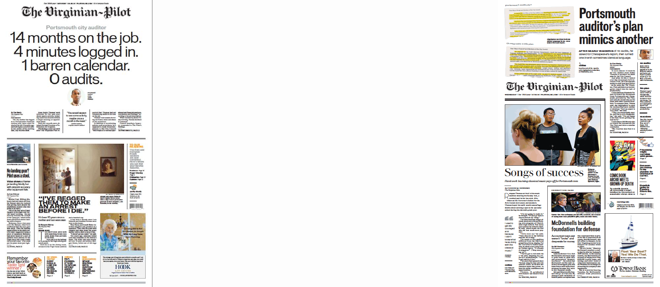
When the settlement was reported on April 13th
Portsmouth topay$300,000 tosettledefamationcases
Portsmouth has agreed to pay more than $300,000 to settle a pair of defamation lawsuits lodged by the city's fired auditor, ending years of legal wrangling over comments that council members made about his job performance.
In an email, Connell added, "Psimas's and Moody's comments cost the city more than the city paid Thomas for his three years of work."
The article did include this… Virginian Pilot 4-13-19
Thomas was hired in April 2013, and the following three years were tumultuous. The Pilot reported in June 2014 that he had logged into the city's financial system twice in his first 14 months on the job. When he produced an audit plan, 15 months into his tenure, it resembled documents he had received from the Chesapeake auditor's staff days before.
But it also still included this… Virginian Pilot 4-13-19
26

Slide 27
Furthermore:
The fired City Auditor settled both cases with the City on March 28, 2019
The newspaper didn’t report the settlement online until Friday afternoon on April 12th, and not in the print version until Saturday April 13th . (> 2 weeks later)
The local TV news reported it on April 15th
https://www.13newsnow.com/video/news/local/mycity/por tsmouth/city-of-portsmouth-settles-lawsuits-with-fired- auditor/291-c8c9f602-6fb3-44da-83a0-c8464a4371db
WVEC News 4-15-19

Slide 28
Closing Tips to avoid ‘non’ successes…
Make sure that your superiors have a thorough understanding of the change and what to expect
Push back if someone is getting it wrong

Slide 29
Finally, $300K may not quite be Winthorp and Valentine rich…
https://www.youtube.com/watch?v=RLySXTIBS3c
Trading Places - 1983
But, after all that wonderful publicity, (plus how hard it is to win one of these things), I’m sure the fired City Auditor and his attorney won’t give it back.

Slide 30
QUESTIONS?
jpoole@cityofchesapeake.net

