Slide 1



Financial Management & Data Analytics:
A National Enterprise & Local Perspective
Mr. Andrew Morgan
Deputy Chief of Staff (G-8)
US Army Training and Doctrine Command
24 APR 2019
http://www.tradoc.army.mil/

Slide 2

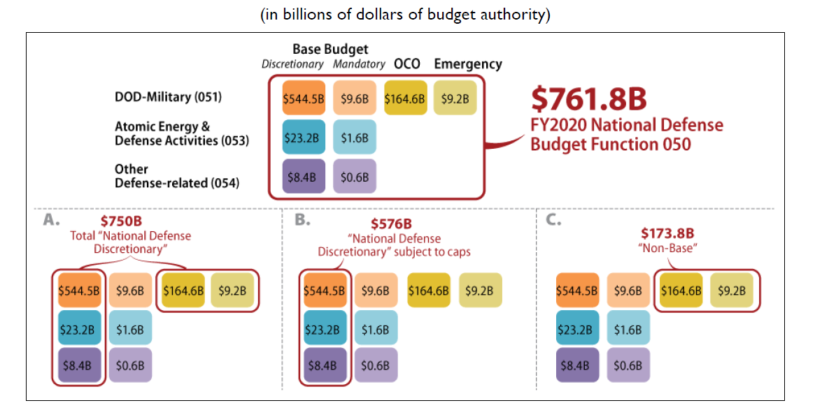
FY2020 National Defense Budget Request
Source: Office of Management and Budget, Analytical Perspectives, Table 29-I, Budget Authority and Outlays by Function, Category, and Program; Department of Defense, Defense Budget Overview for Fiscal Year 2020, March 2019.
Notes: Totals may not sum due to rounding.
1

Slide 3
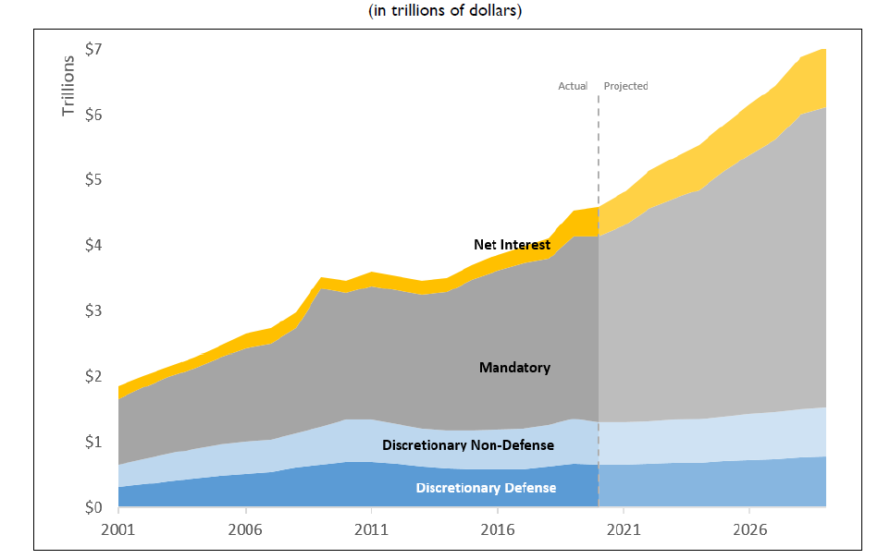
Outlays by Budget Enforcement Category, FY2001- FY2029
Source: OMB, Historical Tables, Table 8.1, Outlays by Budget Enforcement Act Category: 1962-2024; CBO, The Budget and Economic Outlook: 2018 to 2028 and the data supplement 10-Year Budget Projections from January 2019.
Notes: Figures from FY2001 through FY2019 from OMB; projections from FY2020 through FY2029 from CBO.
2

Slide 4
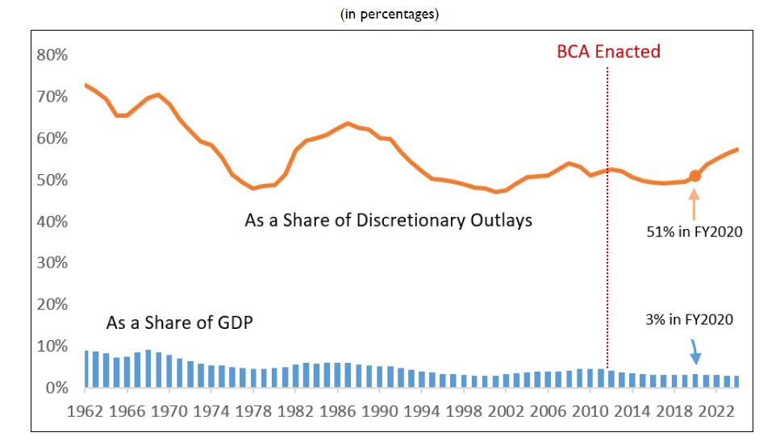
Defense Outlays as a Share of Discretionary Outlays and GDP, FY1962- FY2024
Source: OMB Public Budget Database, Outlays XLS; for GDP, OMB Historical Tables, Table 10.1 Gross Domestic Product and Deflators Used in the Historical Tables: 1940-2024
Notes: FY2019 through FY2024 reflect estimated amounts.
3

Slide 5
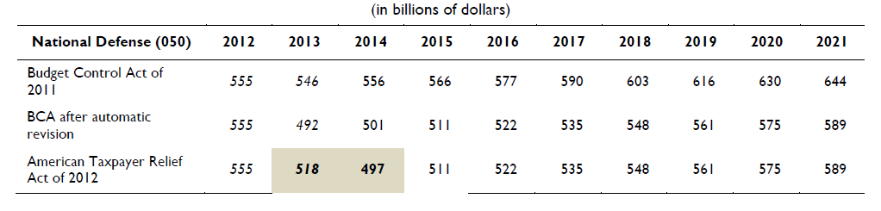
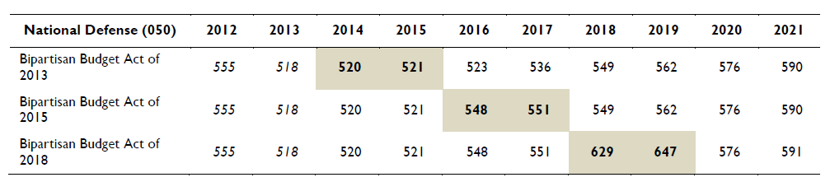
BCA Limits on National Defense (050) Discretionary Base Budget Authority
Source: CBO, letter to the Honorable John A. Boehner and Honorable Harry Reid estimating the impact on the deficit of the Budget Control Act of 2011, August 2011; CBO, Final Sequestration Report for Fiscal Year 2012, January 2012; CBO, Final Sequestration Report for Fiscal Year 2013. March 2013; CBO, Final Sequestration Report for Fiscal Year 2014, January 2014; CBO, Final Sequestration Report for Fiscal Year 2016, December 2014, CBO, Sequestration Update Report: August 2017, August 2017; CBO, Cost Estimate for Bipartisan Budget Act of 2018, February 2018.
Notes: Bold and shaded figures indicate statutory changes. Figures do not include funding for Overseas Contingency Operations (OCO), emergencies, or disaster relief. The BCA as amended provided for “security” and “nonsecurity: categories in FY2012 and FY2013: italicized figures denote CRS estimates of budget authority for defense and nondefense proportional allocations of automatic enforcement measures as calculated by OMB; for more information on these adjustments, see CBO, Estimated Impact of Automatic Budget Enforcement Procedures Specified in the Budget Control Act, September 2011. This table is an abridged version of one that originally appeared in CRS Report R44874, The Budget Control Act: Frequently Asked Questions, by Grant A. Driessen and Megan S. Lynch.
4

Slide 6
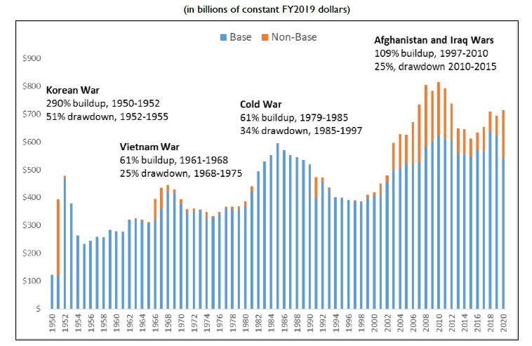
DOD Budget Authority: A Historical Perspective
Source: CRS analysis of Department of Defense, Defense Budget Overview for FY2020, March 2019; DOD, National Defense Budget Estimates for FY2019; Table 6-8: DOD Budget Authority by Public Law Title (FY1948-FY2023), Table 2-1: Base Budget, war Funding and Supplementals by Military Department, by P.L. Title (FY2001-FY2019), and Table I-9: National Defense Budget Authority-Discretionary and Mandatory, April 2019; DOD, FAD-809 table, January 1978; Congressional Budget Office, Final Fiscal Year 2018 House Current Status of Discretionary Appropriations, as of September 30, 2018; Congressional Budget Office, Fiscal Year 2019 house Current Status of Discretionary Appropriations, as of October 5, 2018; Congressional Budget Office, Supplemental appropriations reports from the 1970s -2000s; Office of Management and Budget, Historical Tables, 10.1, and Analytical Perspectives, 29-I.
Notes: 1950-2017 nominal DOD funding from DOD Table 6-8; 2018, 2019, and 2020 nominal DOD funding from OMB Table 29-I and DOD Defense Budget Overview; 1950-1977 nominal DOD non-base funding from DOD FAD-809 table; 1978-2000 nominal DOD non-base funding from CRS research; 2001-2017 nominal DOD non-base funding from DOD Table 2-1; 2018-2019 nominal DOD non-base funding from CBO Current Status of Discretionary Appropriations tables and DOD table I-9; 2020 nominal DOD non-base funding from DOD; nominal figures adjusted to constant FY2020 dollars using calculations based deflators in OMB Table 10.1.
5

Slide 7
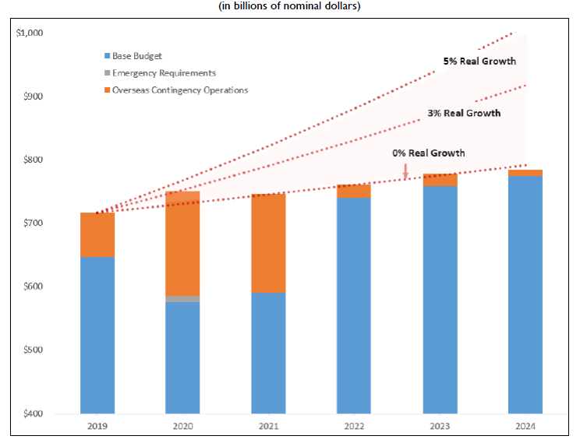
Proposed Defense Discretionary Funding Levels in 2020 Budget
Source: Office of Management and Budget, Table S-7, Proposed Discretionary Funding Levels in 2020 budget; Amounts adjusted for inflation using GDP (Chained) Price Index from OMB Historical Tables, Table 10.1, Gross Domestic Product and Deflators used in the Historical Tables: 1940-2024.
6

Slide 8
CFO of the Future
7

Slide 9
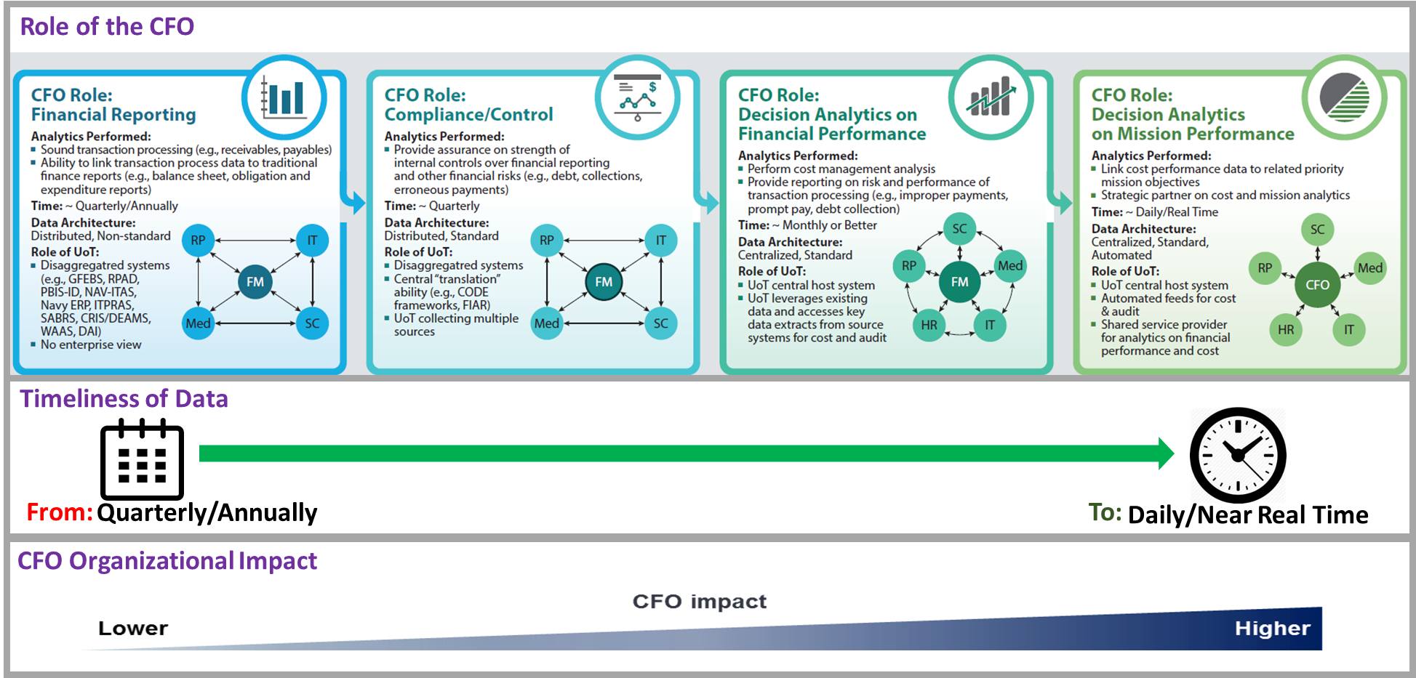
Centralized, Standardized CFO Function: Real Time Insights
8

Slide 10

Hype vs. Reality?
9

Slide 11
Data Analytics
Concept of data analytics is not new
CFO act of 1990 empowered modern govt. CFOs to create enterprise-wide analysis
Purpose of the modern CFO's office
Bring more effective general and financial management practices to the federal government
Provide for improvement of accounting systems, financial management practices, and internal controls
Provide for complete, reliable, and timely data to better finance, manage, and evaluate government programs
10

Slide 12
What is Different Now?
Strong demand from leadership
Audit
Technology
We are actually seeing value
  UoT – focus on 4th Estate, All Services … need driven by audit AND ability to see ourselves
  Cost management – impacts all
11

Slide 13
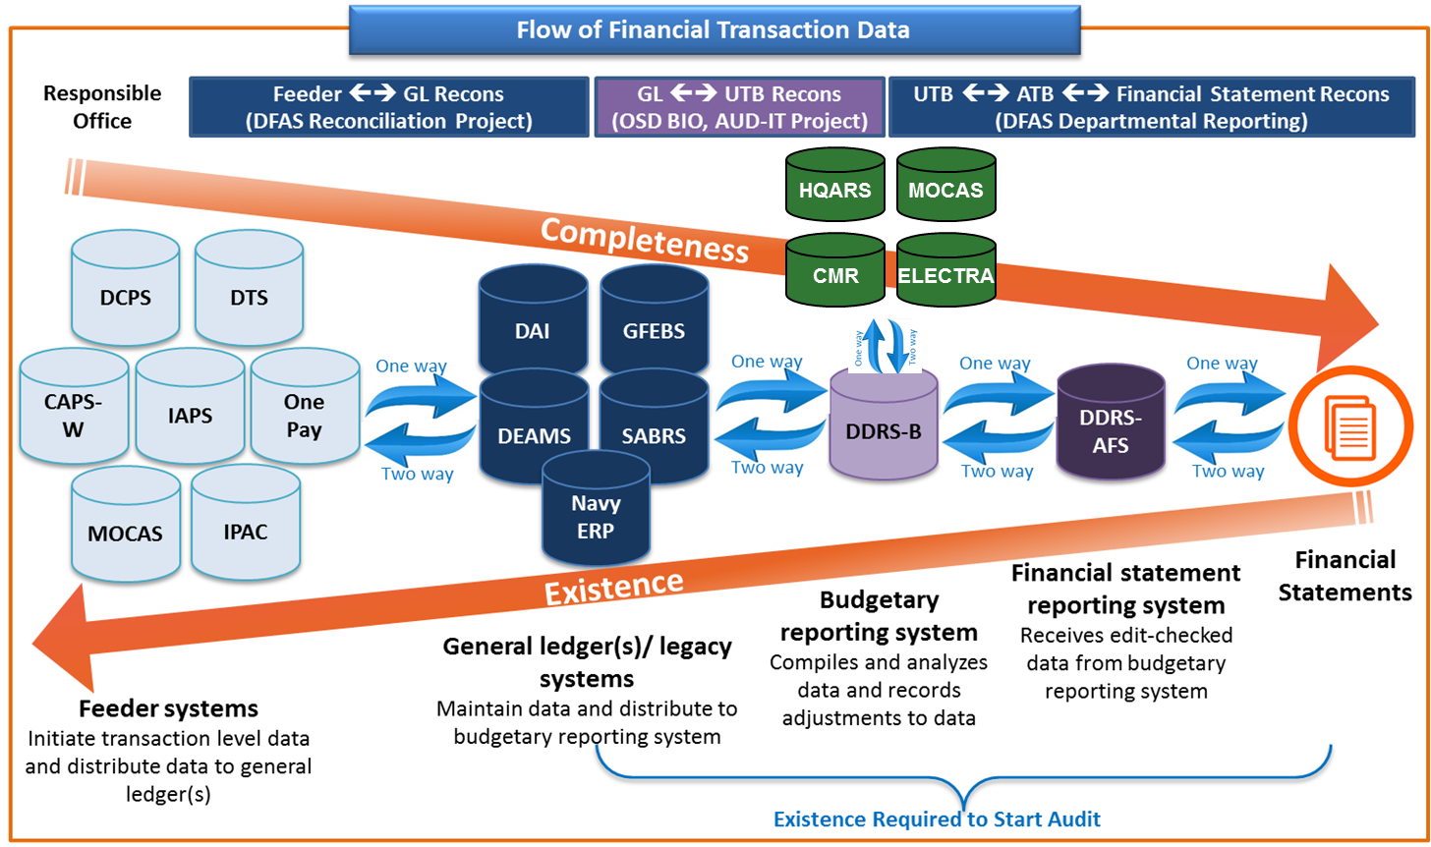
UoT Existence and Completeness Flow
12

Slide 14
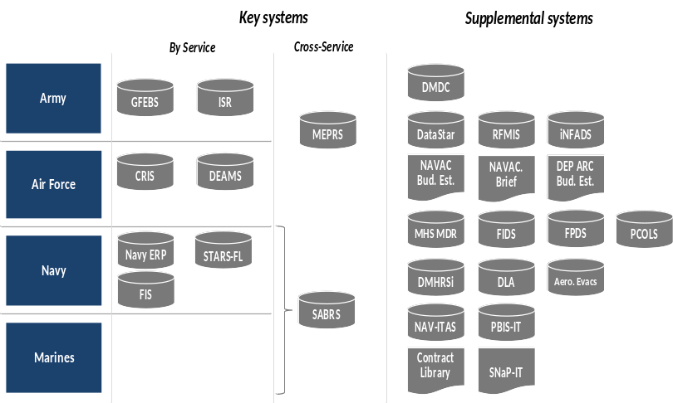
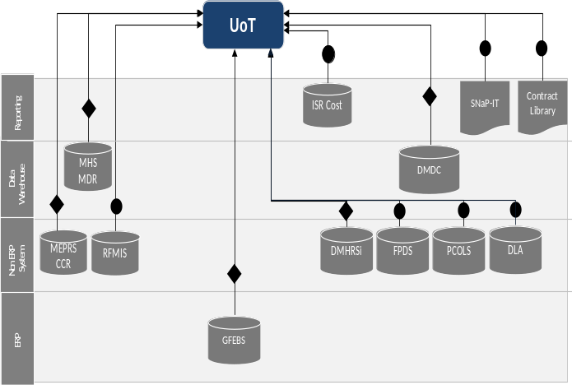
Data Architecture: Centralized Architecture will Enable Better Governance and Automation
Current DOD System Landscape
Future State Use of UoT
Distributed data and management environment
Some integration, but lacking visibility to full spectrum of DoD data
Insights limited to single line of business or organization
Retention of current disaggregated system structure
UoT collects data from multiple sources
Creation of a "Rosetta Stone" to allow for enterprise-level views
Siloed data
Enterprise view with UoT
DoD data source system
13

Slide 15
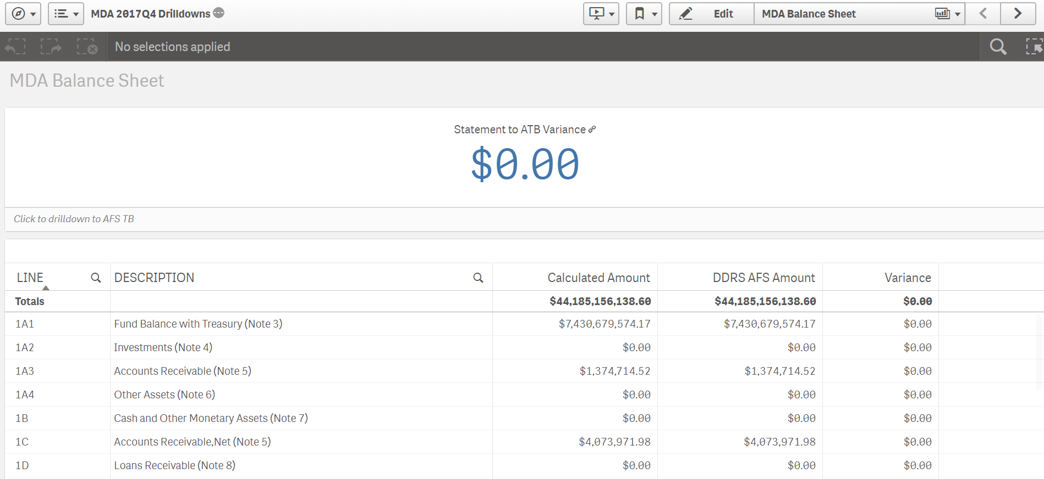
Use Case 1: Reconciliation
Can we trace this?
14

Slide 16
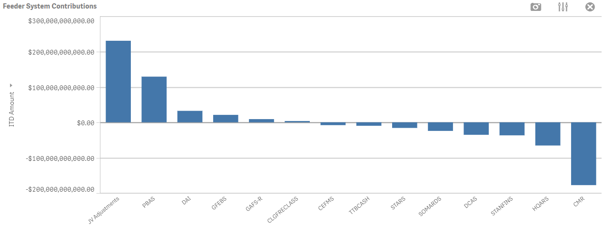
Use Case 1: Reconciliation
When the following is true?
All of these systems, plus 15,000+ rows of crosswalks support FBWT
15

Slide 17
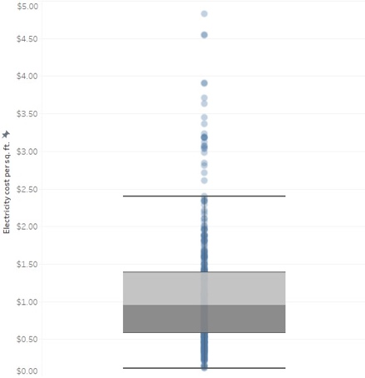
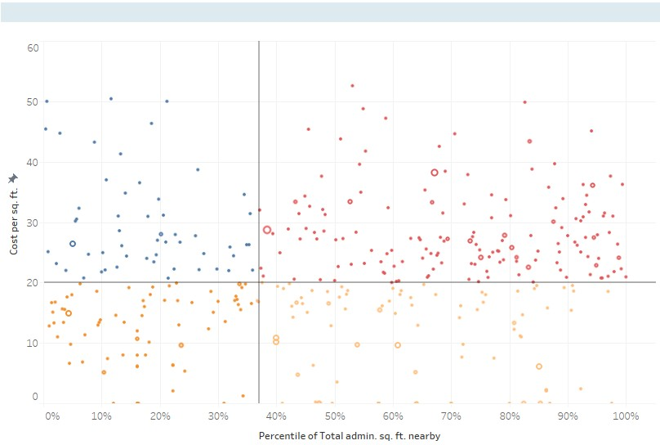
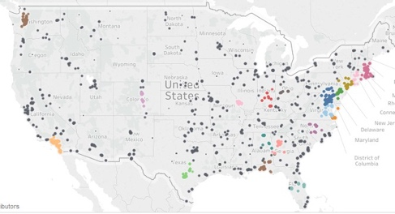
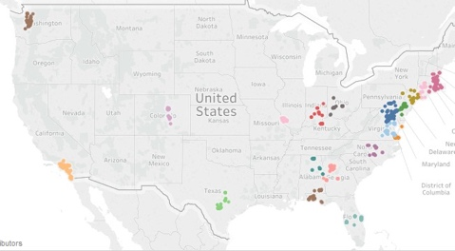
Use Case 2: Cost Management Real Property
      Wide variation in
      electricity spend
      Significant lease spend near existing DOD facilities
      Identification of regional clusters
Estimate potential savings through establishing and managing to cost performance baselines
Leased administrative space is within a 30-mile commute of dense DOD footprint
Potential for CODE analytics to inform regional consolidation
Above: Electricity cost per square foot plotted for 400+ installations across all Services (each dot is different installation)
Above: Administrative leases arrayed according to cost and amount of “nearby” owned/leased administrative facilities
Top: DoD sites with administrative square footage. Bottom: Top 20 “high density” clusters of administrative facilities
16

Slide 18
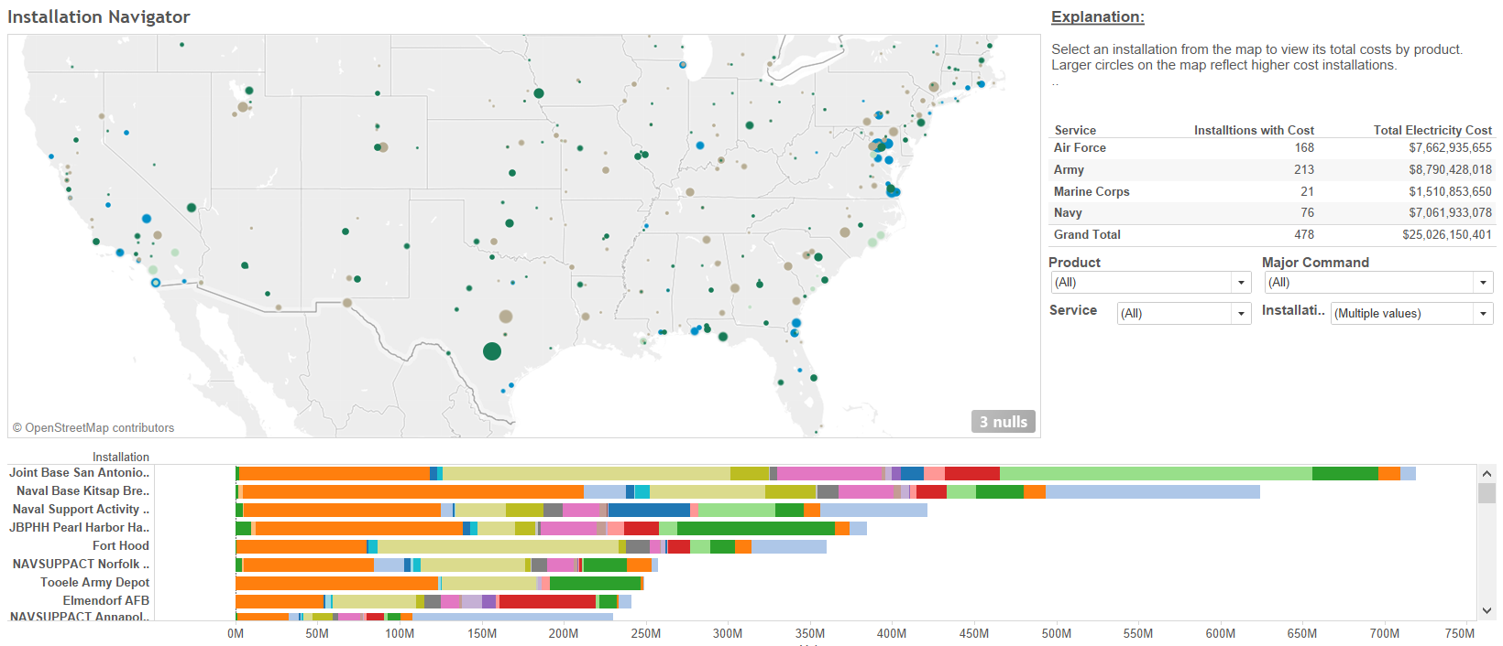
Use Case 2: Cost Management Real Property
17

Slide 19
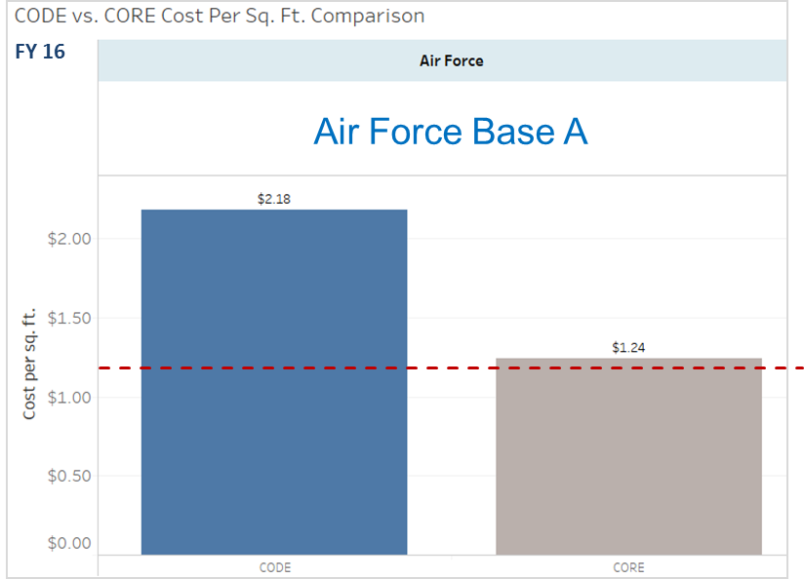
Use Case 2: Cost Management
Electricity Spend at Air Force Base A
Electricity cost per square foot comparison vs. CORE benchmarks:
Air Force Base A Cost Analysis:
~ $7.5 Million
~ 3.44 Million Square Feet
$2.18 / Square Foot
Total FY 16 Electricity Cost*
Total Square Feet
Cost per Square Foot
Cross Service Regional Median: $1.12 / Square Foot
Next step: Review and identify best practices being employed at installations outperforming commercial reference model
18

Slide 20
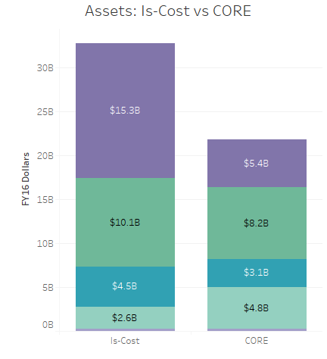
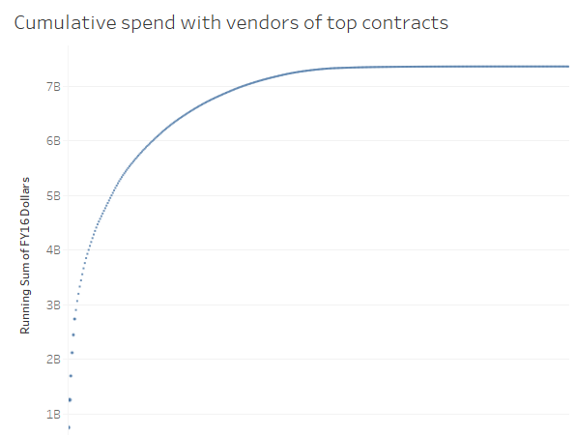
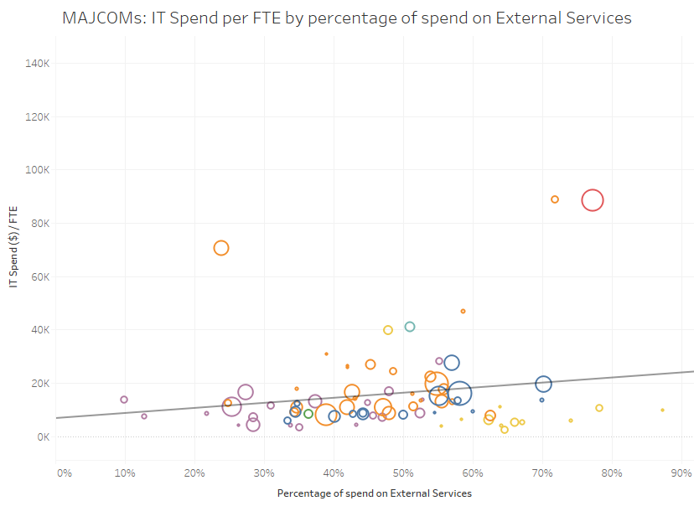
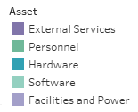
Use Case 2: Cost Management Information Technology
      Higher spend compared to Commercial References
      Lack of consolidation in third party vendors
      Inefficiencies in usage of external service providers
Delta with Commercial Reference model, driven primarily by:
  External services
  IT personnel
High concentration with top vendors, with long tail of spend
IT spend/FTE increases in MAJCOMS that have greater % of spend on external services
19

Slide 21
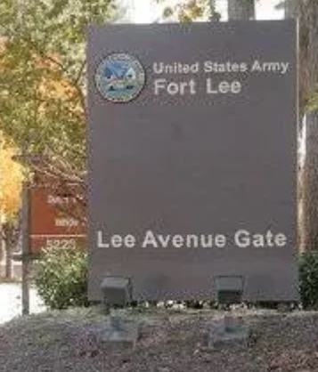
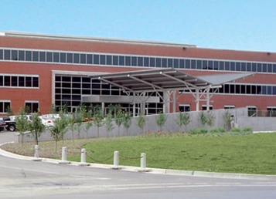

Insight to Action
This all means nothing, unless …
Local
Willingness to make reconciliation a DAILY habit
Willingness to change processes
Shared Service
Willingness to adopt culture of data
Willingness to take calculated risks
System Level
Willingness to make system changes
Willingness to make agency performance a priority
GFEBS
DEAMS
SABERS/NERP
EBS
20

Slide 22
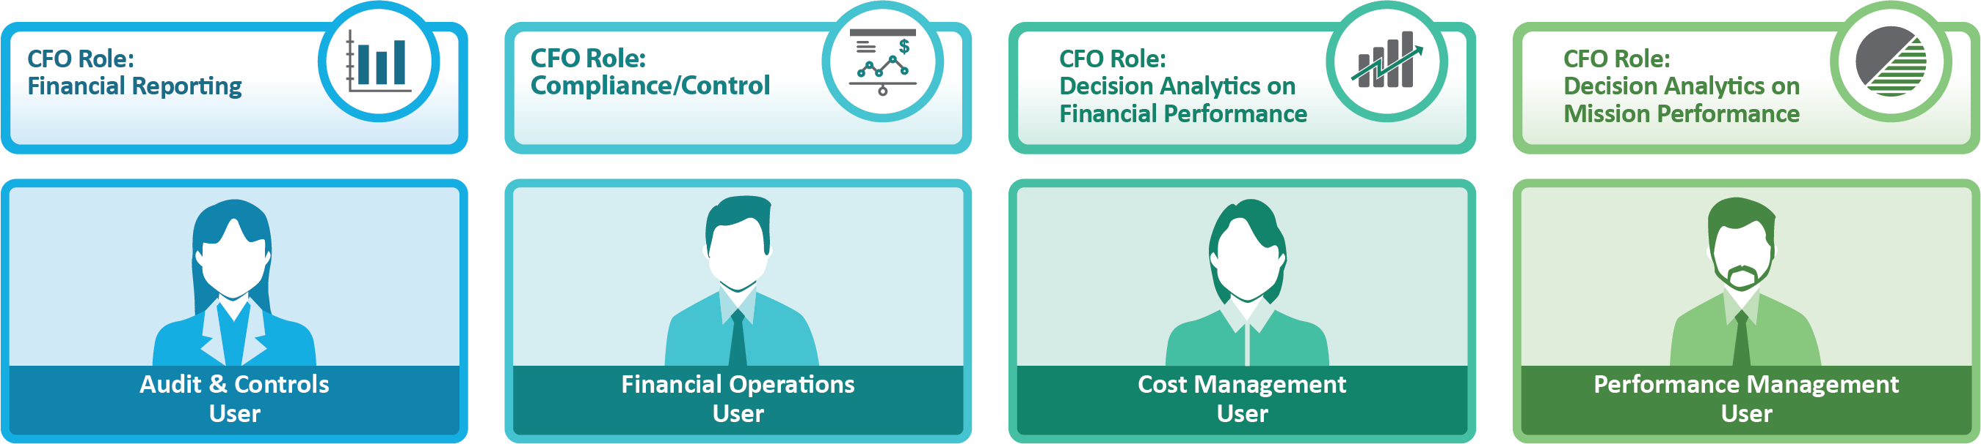




CFO of the Future
Evolving the role of the CFO to a Data Driven
Performance Management Organization
Auditor/Accountant
Budget Analyst
Executive
Portfolio Manager
Insights
Pre-Canned
Dashboards
Self-Service Analytics
Ad-Hoc Query
We Develop:
We Provide:
DRCED AS A
SOFTWARE & SOLUTIONS
PROVIDER
Applications
Dashboards
Interfaces
Training
Onboarding
User Forums
DRCED AS A
DATA PROVIDER
We Maintain:
Automated Data Pipelines
Analytic Queries
Data Access Solutions
Custom Data Views
Accredited Infrastructure
Data Sources
21

Slide 23


Design Challenges: Demystifying Big Data
BELIEF
vs.
REALITY
“If I combine all my data together I will have full insight
into what my organization is trying to accomplish”
Policies, restrictions, and security need to continue to be enforced and the original origin of the data and any changes to it need to be tracked throughout the life of the data asset
“If I leverage industry technologies, I will be successful”
Successful organizations leverage industry technologies, but they also adopt an agile culture that enables them to try new ideas and pivot quickly based on lessons learned
”Once I have all my data in one place, I can focus on analytics”
Stored data needs to be cataloged to enable analysts. Information such as data set name, data formats, data tagging, release-ability, retention, and other metadata must be available.
“There aren’t enough data analytic experts to ask the right questions”
Data driven solutions need to create capabilities that democratize analytics to a wider audience
“The more data I have, the more questions I can answer,
the more knowledgeable my organization will be”
It’s about the right data, combined with the right tools,
for the right problem— not how much data is stored
“Through 2017, 60% of big data projects will fail to go beyond piloting and experimentation, and will be abandoned.”
Gartner, http://www.gartner.com/newsroom/id/3130017
22

Slide 24
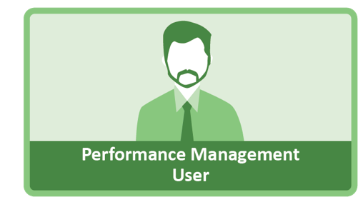




Enabling Self-Service Analytics through Data Discovery
Data Provider
Software and Tools
Automated Data Profiling and Tagging
Configurable, SLA based, Data Pipeline with conformance to Common Data Model
Automatic data tagging, profiling, and lineage mapping on ingest
Dashboard
Pre-canned analytic dashboards supporting trusted analytical models for Financial Analytics
Custom, use case specific app development using industry leading tools such as QLIK
User Starts With:
What questions do I want ask of my data?
IT enables answering the tough questions:
What data do I need to answer my business questions?
Where is the data that I need?
What does this data mean?
How do I access the data I need?
Can I trust the data available?
Searchable Data Catalog
Customized and standard metadata model for quick search and workflow automation
Easy view Data Lineage Reporting from raw to curated data sets depending on use case
Workbench
Suite of tools accessing a secure API, enabling,
ad-hoc analytics
Perform transformation, data wrangling, data science on raw and curated data
Application Integration
Robust API conforming to data aggregation security parameters
Centrally managed authentication for custom app development or access
Data Portal
Preform Large File ingest with automated data checks, tagging, indexing and notifications
Monitor data ingest and egress across the platform according to user profile and job ID
Data Strategy/Data Governance
Rigorous CM of data model and reporting on data drift
End-to-End Data traceability for FISCAM reporting and audit controls
Robust community for establishing best practices and MOAs
23

Slide 25
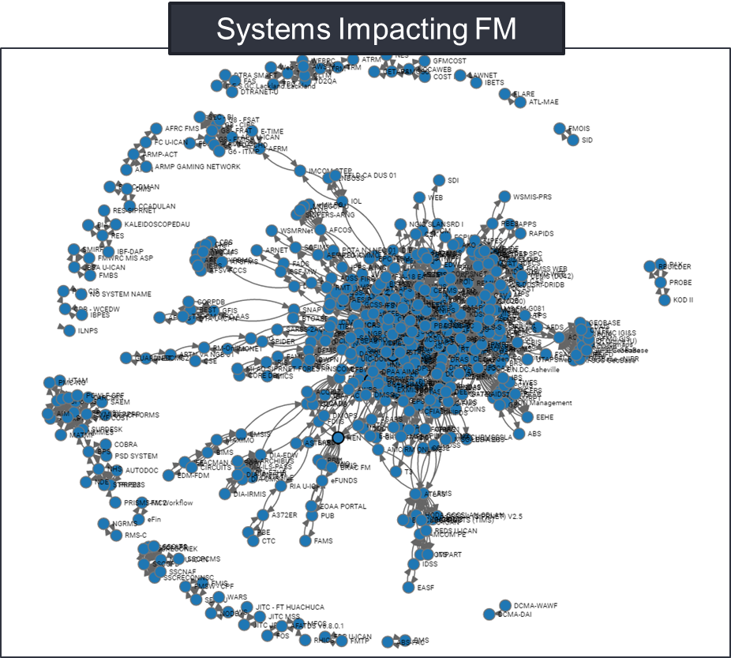
Transforming General Ledger (GL) Data Analysis
Prior to DRCED, interacting with GL data has been:
  Very difficult due to limited system access for each system
  Further limited as each system has different reporting, querying, and data structures
  Incapable of querying multiple systems for common data fields
  This complex environment has challenged the Department for decades due to:
  Point solutions with no overall IT business system strategy
  Redundant processes, data, and systems
  Complex crosswalks are required to link source business events to summary statements and reports
  Agency-specific, non-interoperable systems
  Much more …
Roughly 70% of DoD systems material to audit and cost are not in the FM portfolio
24

Slide 26
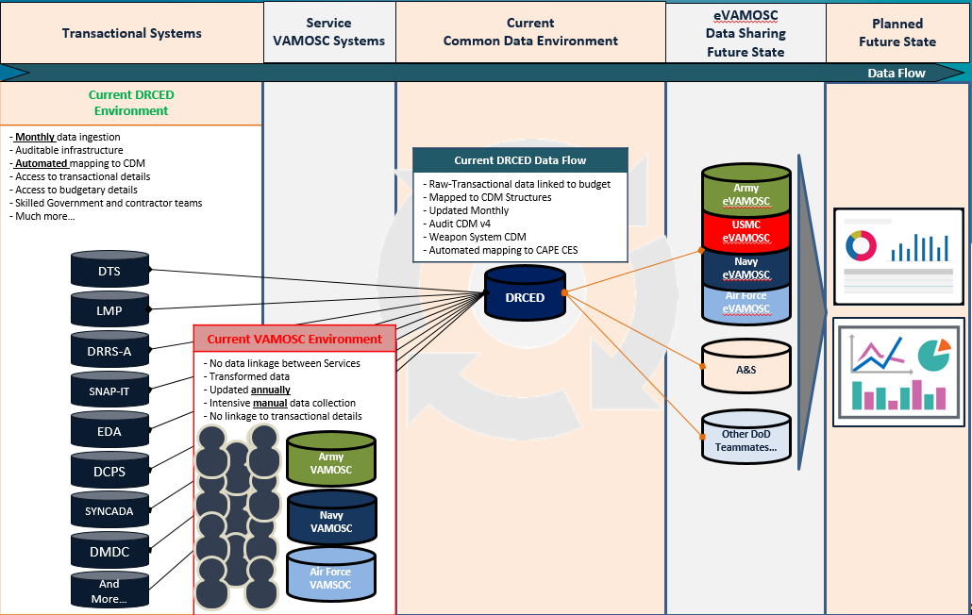
Operations and Support (O&S) General Ledger Mapping to CAPE CES Example
25

Slide 27

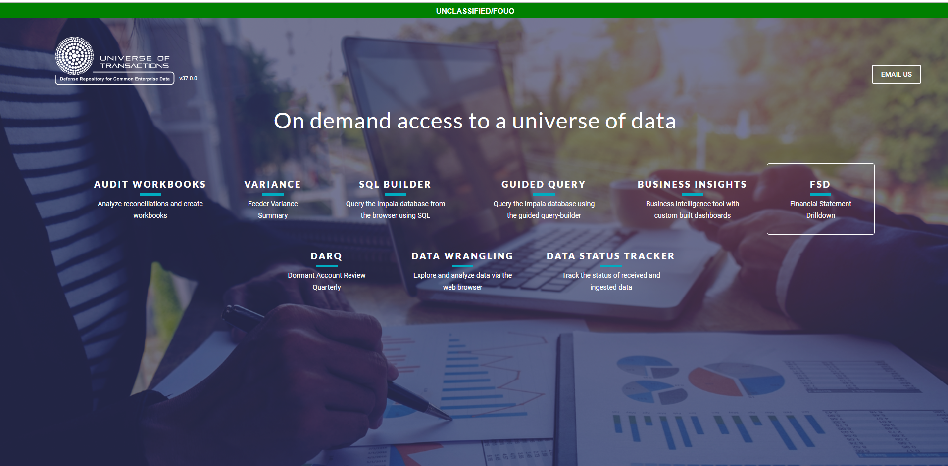
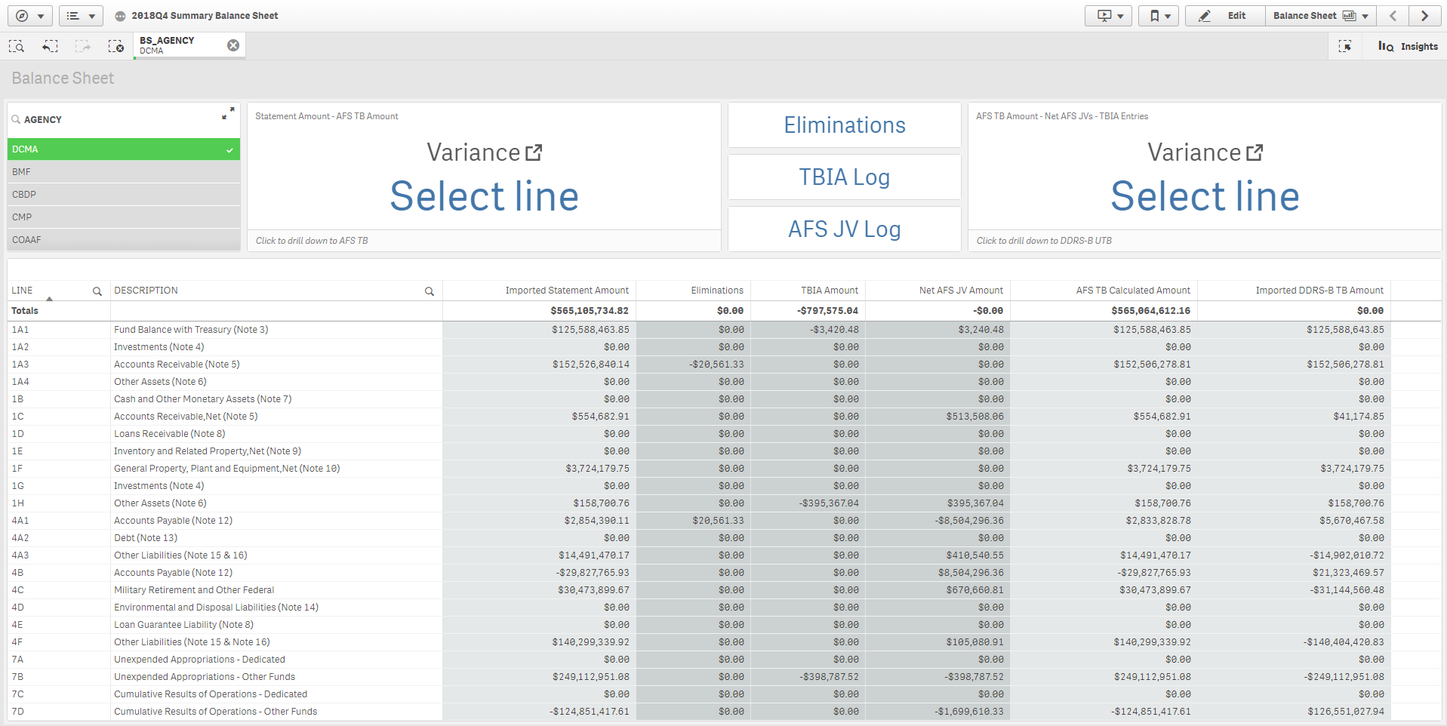
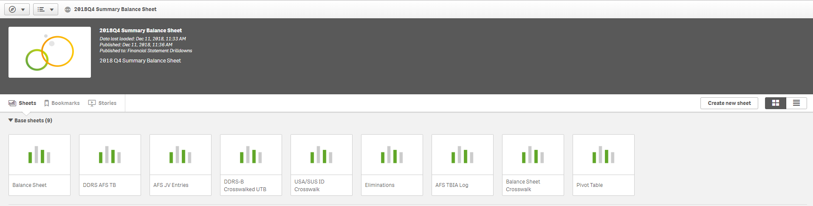
Financial Reporting
DRCED has automated numerous financial reporting tasks
Financial Statement Drilldown (FSD)
Feeder variance summaries
Automated Mapping of 30+ General Ledger (GL) Systems
26

Slide 28
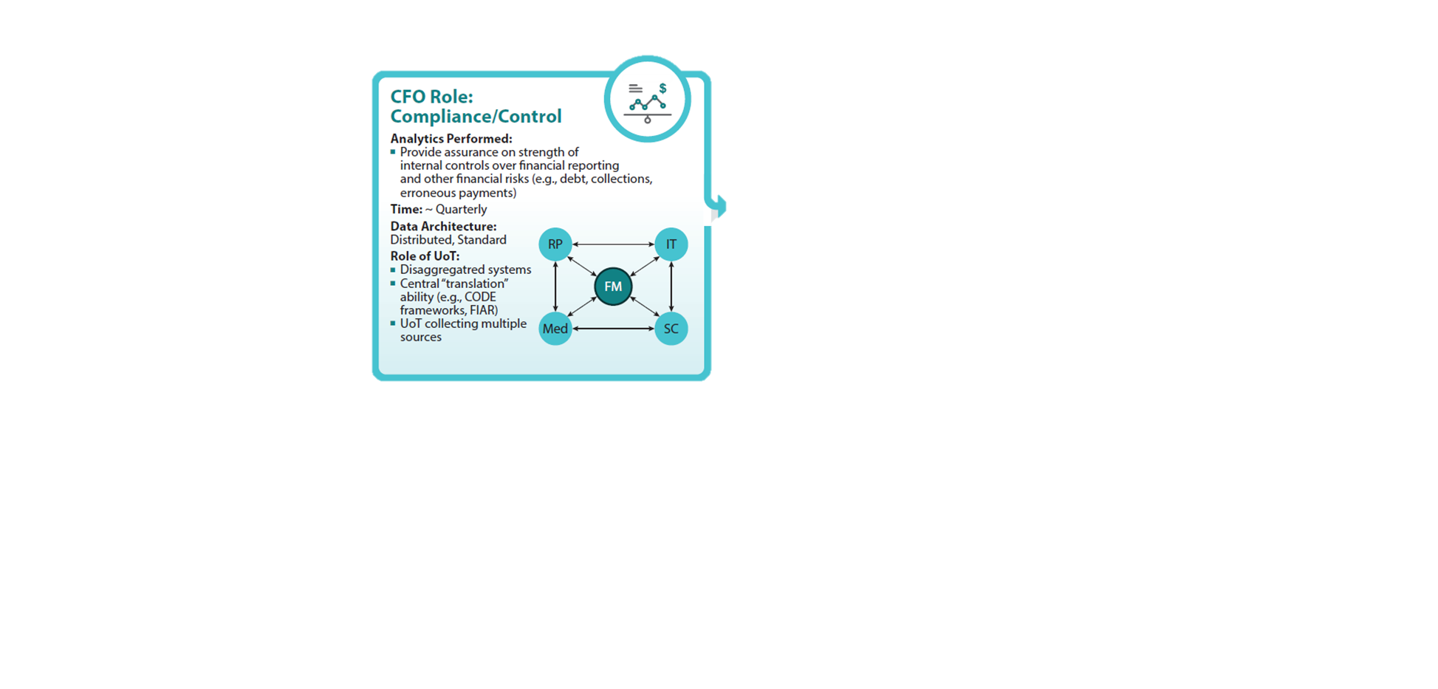
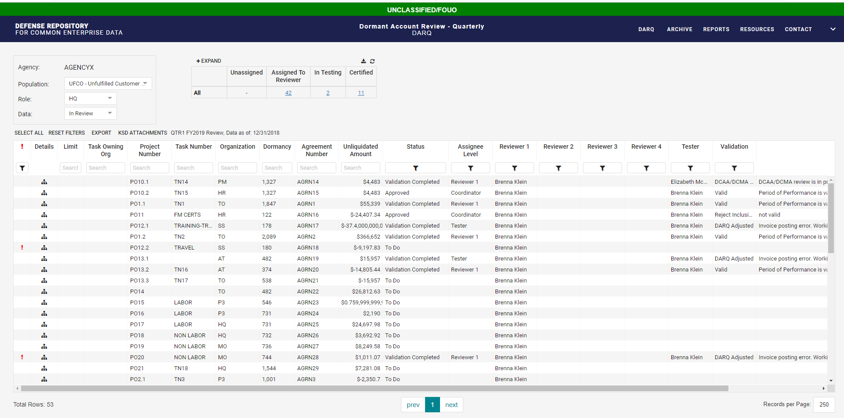
Compliance and Control
DRCED is helping improve compliance and control
Robotic process automation
Audit workbooks
Automated data quality tracking
Dormant Account Review Quarterly (DARQ)
27

Slide 29
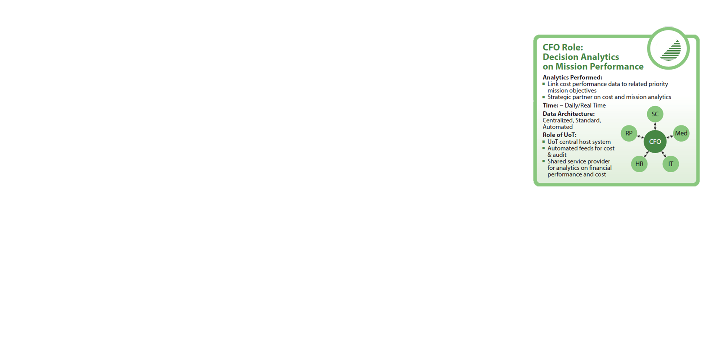
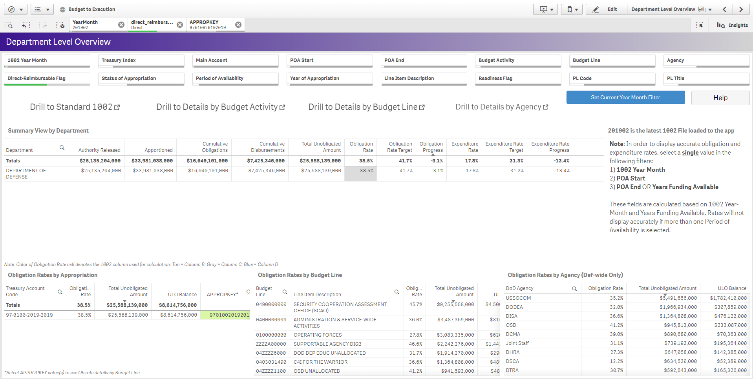
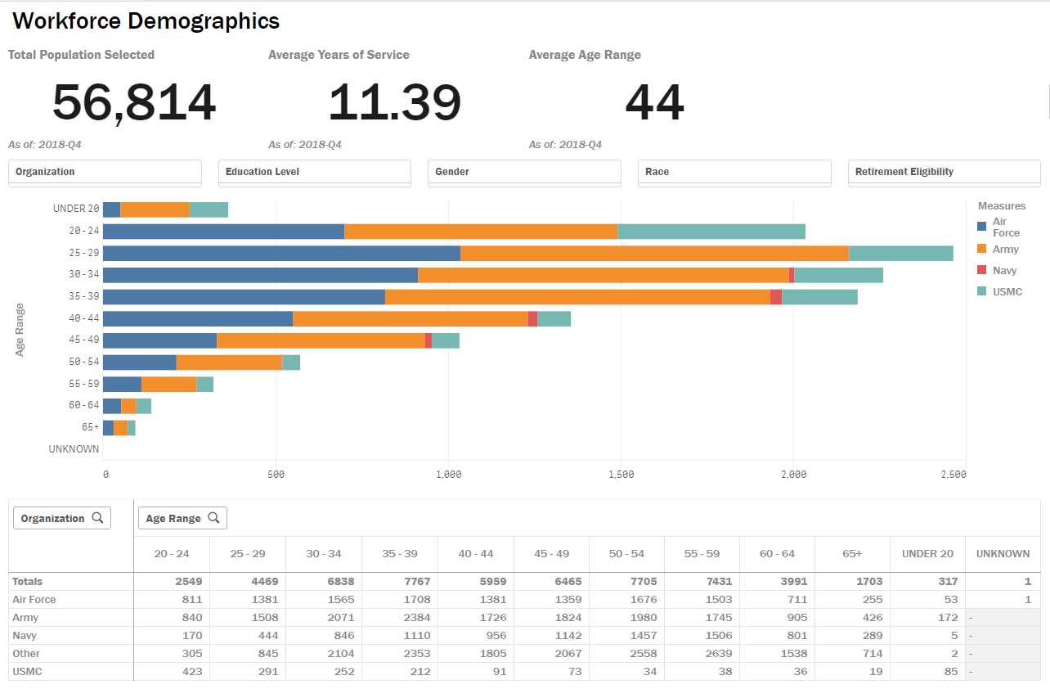
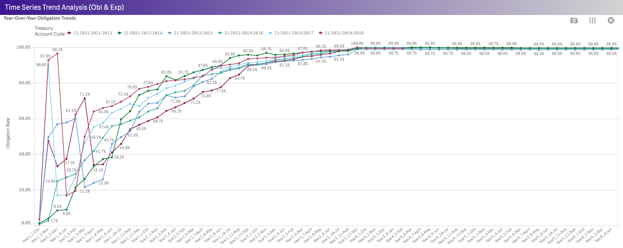
Decision Analytics on Mission Performance
DRCED will help modernize mission performance analytics
Budget analytics
Human resource analytics
Contract analytics
Real property analytics
Medical analytics
Readiness analytics
Acquisition analytics
More…
28

Slide 30
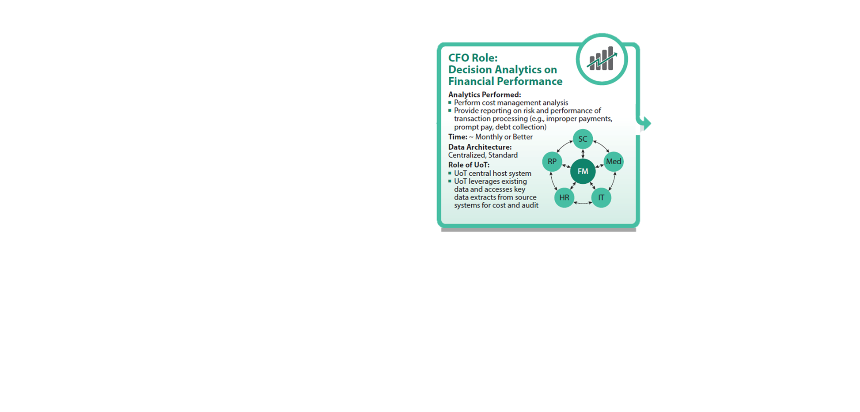
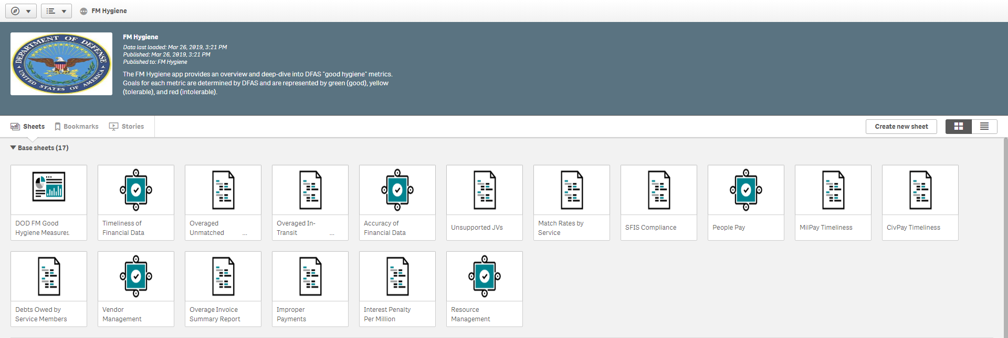
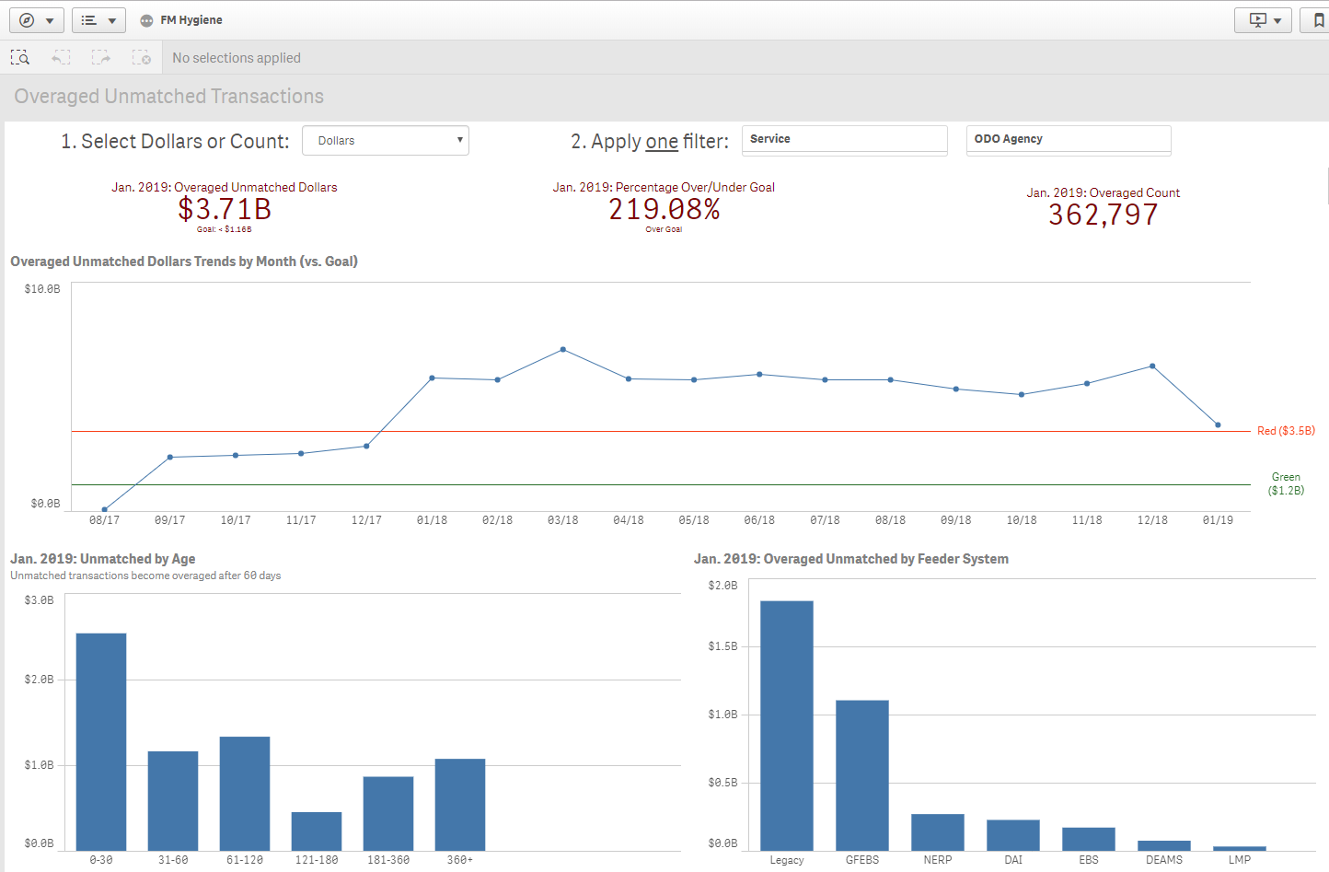
Decision Analytics on Financial Performance
DRCED is bringing new decision analytics to financial performance
Financial management hygiene
General Ledger (GL) mapping to other business systems
Financial management workforce tracking
Detailed contract analytic capabilities
29

Slide 31
So What Does All This Mean?
This is YOUR future!
Budget environment necessitates us to make and advise better resource decisions
Need to embrace & upgrade IT tools
Data analytics enables professional and organizational relevance
Wise man say: “ He who learn data analytics feed family for long, long time.”
30

