Slide 1


Department Of The Navy,
Financial Management & Comptroller
Financial Management Transformation

Slide 2



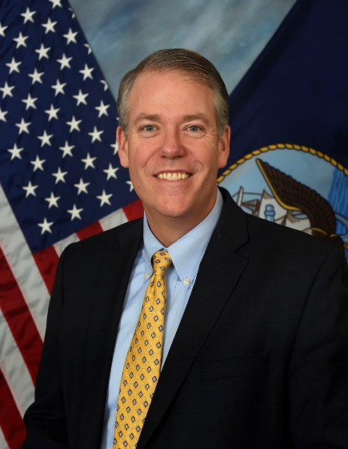


Message from ASN(FM&C)
“FY 2018 marks the first year where the entire Department of the Navy (DON) underwent a full financial statement audit. The audit was broken out into three parts: the Navy General Fund, Marine Corps General Fund and DON Working Capital Fund.
The results of all three audits were disclaimers of opinion. This is the outcome we expected, and we expect to continue to get disclaimers for several more years as we work to remediate the material weaknesses in internal control.
It will be a multi-year effort. As we continue with annual audits, we will use the audit process as a tool to improve our financial management systems, processes and controls.
While the audit revealed numerous material weaknesses in internal control over financial reporting, more importantly, it highlighted several areas where the DON needs to improve operationally, in order to improve lethality and readiness. The financial statement audit forced us to look at our supply chain in a new light, and has caused us to challenge much of the thinking that existed over the last several decades. The audit identified business practices that are unacceptable and must change, to improve readiness, lethality and auditability.“
Thomas W. Harker
Assistant Secretary of the Navy Financial Management and Comptroller

Slide 3

DON Financial Management Transformation
VISION
By the Beginning of FY 2023:
Operate one general ledger.
Standardize financial & other business processes with documented internal controls tested annually.
Include enterprise risk management & zero based budgeting in POM development.
Manage budget authority inside the general ledger--minimal reimbursables.

Slide 4

DON Financial Management Transformation
Primary Goals
Primary Goals
AUDIT
Continue full-scope audit with full transparency: Prioritize and remediate findings Strengthen internal controls Improve the accuracy of financial reports
BUDGETARY REFORM
Rigorously execute the budget Improve execution effectiveness & transparency Reduce reimbursable work
CONSOLIDATION OF SYSTEMS
Consolidate and reduce feeder and general ledger systems Modernize Navy ERP employing standard business processes

Slide 5
DON Financial Management Transformation
Primary Goals & Respective Focus Areas
Focus Areas
AUDIT
Inventory and Operating Materials and Supplies (OM&S) Real Property Financial Reporting Fund Balance With Treasury (FBWT)
BUDGETARY REFORM
5) Budgetary Reform
8)USMC Audit Remediation
CONSOLIDATION OF SYSTEMS
Business System Consolidation Information Technology General Controls (ITGCs)

Slide 6





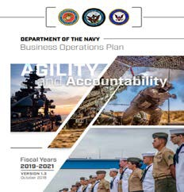
Overarching DON Case for Change
Rooted in the National Defense Strategy (NDS) & DON Business Operations Plan (BOP).
Reforms are essential to achieve DONs aggressive readiness & lethality goals.
National Defense Strategy Line of Effort 3
Reform the Department’s Business Practices for Greater Performance and Affordability
DON Business Operations Plan Strategic Objective 3.3
Undergo an Audit, and Improve the Quality of Budgetary and Financial Information that is Most Valuable in Managing the DoD

Slide 7




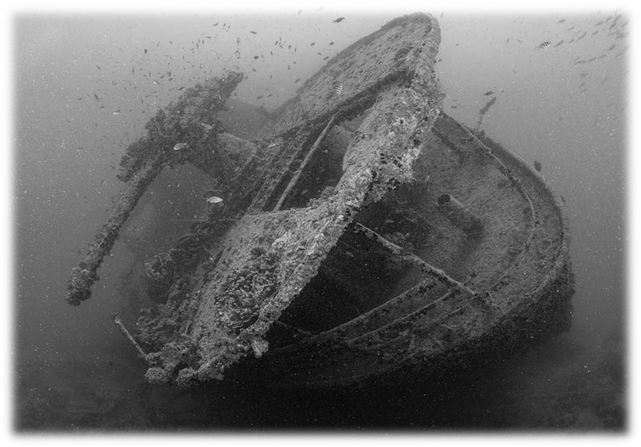


















DON’S Current Reality
20-30% Inventory Error Rates
Lack of Integration Within End- to-End Business Processes
Redundant Financial Management Processes
$ Billions in Annual De-obligations
Fragmented, Localized Systems

Slide 8
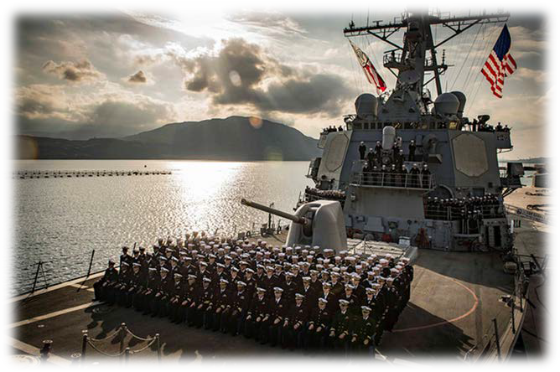
Transformation Will Bring:
The right part in the right place at the right time, every time!
Clear accountability of property, plant & equipment leading to increased warfighter strength & sustainability.
Increased operational effectiveness & readiness.
Improved accuracy & reliability of asset information to make better-informed readiness & warfighting decisions.
More accurate readiness & warfighting requirements.
Improved flexibility & speed in getting capability to the warfighter.
Enhanced workforce competency / training and budget savings through reform.

Slide 9

Primary Goal: Audit
Focus Area 1: Inventory and OM&S
PROBLEM: The DON’s processes, controls, and systems are non-standard and balkanized.
OBJECTIVE | Understand inventory items for quantity, condition, and location. Create standard processes for the receipt, issuance & disposal of inventory. Identify gaps in standard controls to streamline operations. Re-baseline inventory counts throughout the Department. From issuance to disposal, ensure items are properly tracked, recorded & valued.
The Right Part In The Right Place At The Right Time, Every Time!

Slide 10
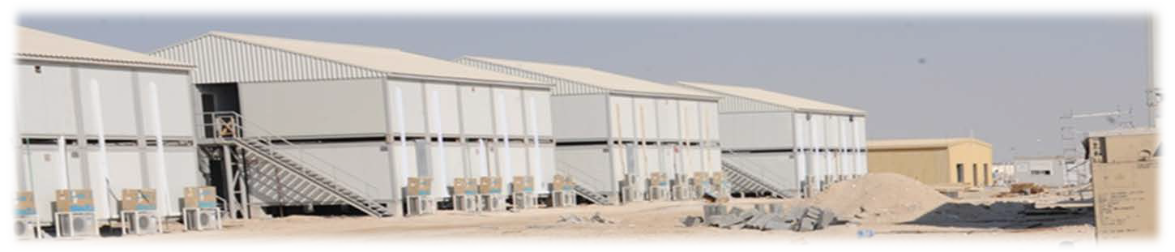
Primary Goal: Audit
Focus Area 2: Real Property
PROBLEM: DON is unable to properly account for real property assets.
OBJECTIVE | Conduct a complete inventory of all real property assets. Improve end-to-end processes allowing for better tracking of property condition throughout its lifecycle. Identify gaps in key controls to streamline operations. Ensure items are properly tracked, recorded and valued.
Better Support To The Warfighter.

Slide 11

Primary Goal: Audit
Focus Area 3: Financial Reporting
PROBLEM: The DON’s systems are not integrated and can not track dollars from point of origination through execution.
OBJECTIVE | Stop making manual changes to financial reports. – Correct internal financial logics in ERP and SABRS. – Eliminate data calls by capturing all financial actions in one system. Stop multiple financial handoffs before execution.
Make Effective Financial Management An Enabler For the Warfighter.

Slide 12


Primary Goal: Audit
Focus Area 4: FBWT Reconciliation
DON does not know its cash balance with Treasury.
OBJECTIVE | Reengineer operational logistics & financial processes from funds receipt through execution to establish & maintain accurate cash balance with Treasury. Consolidate accounting systems. Record funding in the accounting systems accurately and timely. Transition to Treasury Direct Disbursing to facilitate reconciliation with Treasury. Ensure payments and collections are properly, accurately and timely recorded in the accounting system. Implement daily reconciliation processes across the DON.
Increased Operational Effectiveness Through More Effective Use Of Money.

Slide 13
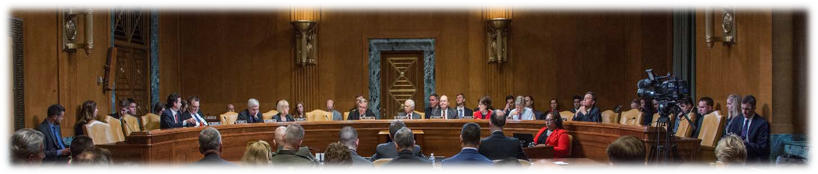
Primary Goal: Budgetary Reform
Focus Area 5: Budgetary Reform
PROBLEM: Spending dollars in a decentralized manner through reimbursable agreements (internal to the Navy and other government agencies) results in loss of visibility of available resources.
OBJECTIVE | Improve transparency and visibility of funds across the DON. Reduce the use of reimbursable agreements and eliminate-direct cite. Consolidate co-located comptrollers. Change the IPAC process so that the buyer always initiates payment (push vs. pull).
More Effective And Transparent Use Of Funding For Warfighting Requirements.

Slide 14
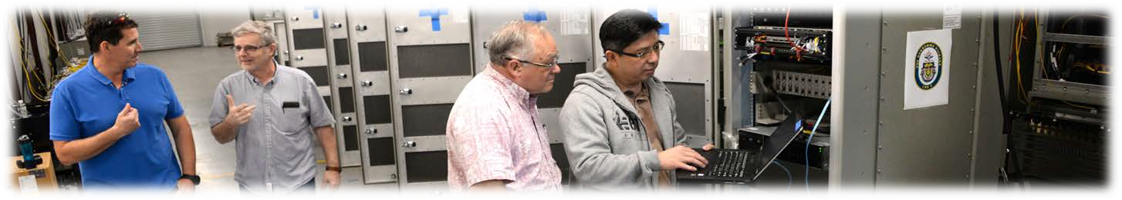
Primary Goal: Consolidation of Systems
Focus Area 6: Business Systems Consolidation
PROBLEM: The DON is riddled with complex & non-standard business processes, non-compliance with data standards, and lack of interoperability between systems.
OBJECTIVE | Consolidate universe of accounting systems to two (Navy ERP and SABRS) by 1 OCT 2020. Upgrade Navy ERP and expand its financial functionalities (funding and procure to pay). Implement SFIS in Navy ERP, correct posting logic and enable Treasury Direct Disbursing.
Flexibility, Speed, And Efficiency In Getting Capability To The Warfighter As A Result Of Integrated Systems.

Slide 15

Primary Goal: Consolidation of Systems
Focus Area 7: IT General Controls
PROBLEM: The DON has very poor controls over its IT systems.
OBJECTIVE | By 2020: Institutionalize risk management framework; i.e., tighter integration of audit requirements into systems development and acquisition process. Increase / Tighten / Centralize oversight over IT security controls. Strengthen DON interoperability & security controls with Shared Service Providers. Retire legacy systems and consolidate into modern systems.
Enhanced Systems Controls To Better Secure And Manage Financial Data.

Slide 16


What’s Next?
DON Financial Management
Thorough, unblinking, and intensive review of risk year after year. Remediate identified root deficiencies. Streamlined processes around funds distribution/execution/reporting with drill-down capabilities to other echelons. Aggressively strive for innovative solutions to shed outdated and non- compliant legacy processes and systems. Relentless commitment to enterprise standardization.

Slide 17
Audit
Budgetary Reform Consolidation of Systems
Department of the Navy, Financial Management
Financial Management Transformation
Backup Slides

Slide 18
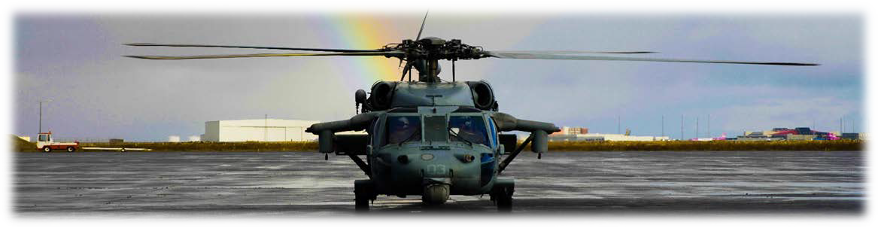
Primary Goal: All
Focus Area 8: USMC Audit Remediation
PROBLEM: After of two years of full audit, USMC continues to have substantial weakness across several focus areas.
OBJECTIVE | Capitalize on long-standing USMC efforts by accelerating: Property and OM&S. Budgetary opening balances. Financial reporting and FBWT.
Joint And Cross-functional Solutioning Of Identified Deficiencies Will Generate Modernized And Innovative Approaches Across USN And USMC.

